Slide 1



CONTENT MARKETING PLAYBOOK
The Small Business Owner’s

Slide 2
TABLE OF CONTENTS
Introduction 3
Identify & Segment Your Audience 9
Discover Where Interests & Expertise Intersect 23
Create & Deliver the Content 34
Measure & Optimize Your Strategy 44
Next Steps 48
Content Marketing Worksheets 55

Slide 3


INTRODUCTION
As a busy business owner, you are in the trenches every day, keeping your business running smoothly.
Creating content might not be at the top of your list…
But it should be.

Slide 4
INTRODUCTION
In fact, small businesses that just blog consistently gain 126% more leads than businesses that don’t.
And that’s just one reason to create compelling content. Others include:
The boost in web traffic you can get from SEO
Having content on hand to share with your social networks
Using content to nurture your relationship with prospects and customers

Slide 5
INTRODUCTION
The Content Marketing Institute and MarketingProfs reported on the small business content marketing trends, budgets and benchmarks for 2015.
The report shows that 39% of companies who have a documented content strategy are:
“more effective in nearly all aspects of content marketing than their peers
who either have a verbal-only strategy or no strategy at all.”

Slide 6

INTRODUCTION
To keep up with your competition, you need to get your content strategy on paper, like the top performers do.

Slide 7
INTRODUCTION
So how do you get your content strategy on paper? This guide breaks it down
into 4 easy steps:
Identify and Segment Your Audience
Discover Where Interests and Expertise Intersect
Create and Deliver the Content
Measure and Optimize Your Strategy

Slide 8
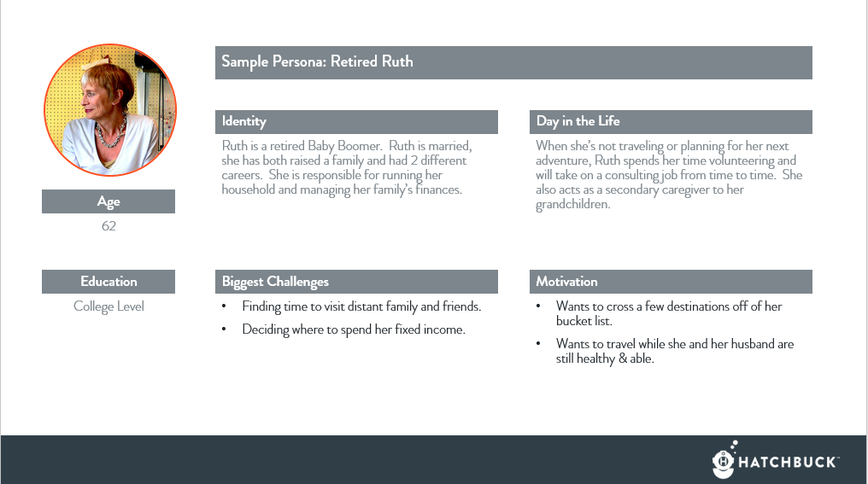
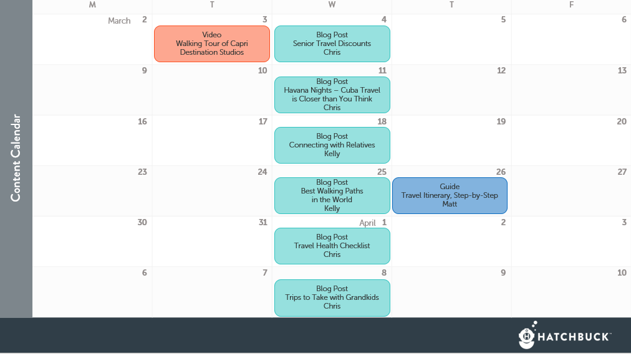
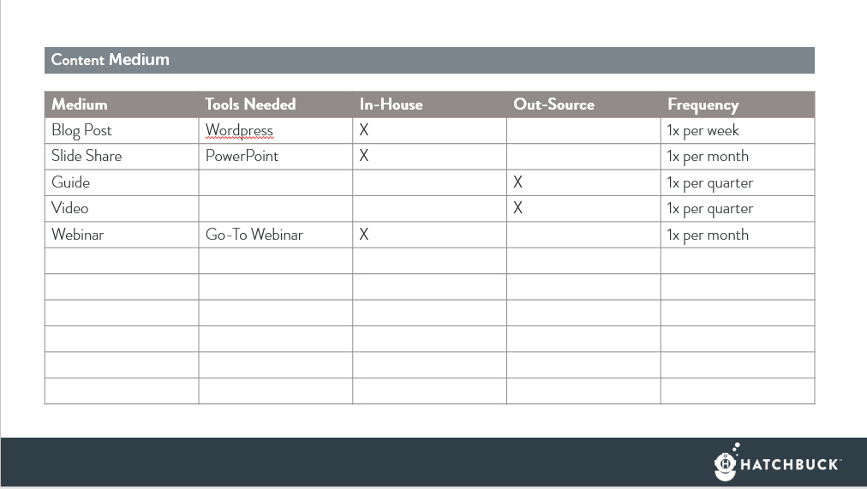
INTRODUCTION
Plus, we’ve added handy worksheets at the end of this guide so you can get your content strategy on paper in a jiff.

Slide 9
1
Identify & Segment
Your Audience

Slide 10
IDENTIFY & SEGMENT YOUR AUDIENCE
The first step to a sound content marketing strategy is to know exactly who you are trying to attract.
According to CMI’s report, small businesses that have seen success with content marketing segment their audience. In fact, the average small business content strategy targets four unique customer segments.

Slide 11

IDENTIFY & SEGMENT YOUR AUDIENCE
To zero in on your audience, create a buyer persona for the types of customers you want to attract to your business.
Buyer Persona: A fictional person, rooted in research, that represents the needs and interests of a specific segment of your audience.
Want to learn more about personas? Check out these Hatchbuck blog posts:
A Simple Introduction to Personas
An Easy Guide to Creating Customer Personas

Slide 12



IDENTIFY & SEGMENT YOUR AUDIENCE
Your target market may be hundreds, thousands, or millions of contacts. Instead of trying to formulate messaging that is generic enough to address them all, lock your sights on two or three types of people on your list.
For example, if you’re travel agency, your target audience may be made up of:
When you segment your audience by these categories, you can start to create more engaging content.
Retirees | Backpackers | Business Travelers

Slide 13

IDENTIFY AND SEGMENT YOUR AUDIENCE
Take Segmentation One Step Further
Personas take initial segmentation one step further by assigning an archetype customer for each group. So, instead of thinking of a group of your customers as “Retired Travelers” personas help you think of them as “Retired Ruth.”

Slide 14
IDENTIFY AND SEGMENT YOUR AUDIENCE
With a strong persona, Ruth isn’t just a retiree.
She’s a 62 year-old empty nester who finally has more free time to explore the world.
She’s married, and she and her husband have been saving for 30 years or more to be able to enjoy retirement.

Slide 15
IDENTIFY AND SEGMENT YOUR AUDIENCE
As you build out Ruth’s persona, you gain insights into how Ruth spends her days, what motivates her, and the types of problems you can help her solve.
With a persona behind your content, you can create a much more compelling content for Ruth and your prospects who are just like her.

Slide 16
Step 1: Craft an Identity
Build a Persona
Find out who your persona is and give them a backstory. Ask:
What is their name?
What generation are they from?
What is their home life like?
What is their level of education?
Joe the single twenty-something is going to have different motivations than Mary the 40-something divorcée with 2.5 kids.

Slide 17
Sample Persona: Retired Ruth
Ruth is a retired Baby Boomer. Ruth is married, she has both raised a family and had 2 different careers. She is responsible for running her household and managing her family’s finances.
62
College Level

Slide 18
Step 2: A Day-in-the-Life
Build a Persona
Think about the routines and processes your persona embarks upon every day. Ask questions like:
Where do they go every day? How do they communicate? What is their role? How do they work? | What is the best way to reach them? What personality characteristics do they possess? What is their environment like?

Slide 19
Sample Persona: Retired Ruth
Ruth is a retired Baby Boomer. Ruth is married, she has both raised a family and had 2 different careers. She is responsible for running her household and managing her family’s finances.
When she’s not traveling or planning for her next adventure, Ruth spends her time volunteering and will take on a consulting job from time to time. She also acts as a secondary caregiver to her grandchildren.
62
College Level

Slide 20
Step 3: Uncover Pain-Points
Build a Persona
Think about the challenges your persona faces and use insights about the daily achievements, struggles, and processes of your persona to uncover what motivates them.
What problems does your persona have?
Where do their obstacles intersect with your expertise?
What specific challenges can you help them overcome?

Slide 21
Sample Persona: Retired Ruth
Ruth is a retired Baby Boomer. Ruth is married, she has both raised a family and had 2 different careers. She is responsible for running her household and managing her family’s finances.
When she’s not traveling or planning for her next adventure, Ruth spends her time volunteering and will take on a consulting job from time to time. She also acts as a secondary caregiver to her grandchildren.
62
College Level
Finding time to visit distant family and friends.
Deciding where to spend her fixed income.
Wants to cross a few destinations off of her bucket list.
Wants to travel while she and her husband are still healthy & able.

Slide 22
Step 4: Validate with Research
Build a Persona
Continue to revisit your personas and help them evolve as you discover more about their real-life counterparts.
Meet with customers in person
Create places for feedback at your brick and mortar location
Send out quarterly surveys with tools like Surveygizmo or Survey Monkey

Slide 23
2
Discover Where
Interests & Expertise Intersect

Slide 24

DISCOVER WHERE INTERESTS & EXPERTISE INTERSECT
58% of small businesses surveyed in the CMI content marketing report say that creating engaging content is the most challenging aspect of content marketing.

Slide 25

DISCOVER WHERE INTERESTS & EXPERTISE INTERSECT
It’s one thing to present the facts and appeal to a rational buyer. But buyers aren’t rational.
80% of the time, they make decisions based on their gut. To build trust in your brand, you need to tap into your audience’s emotions.

Slide 26
DISCOVER WHERE INTERESTS & EXPERTISE INTERSECT
Now that you know who you’re targeting, it’s easier to determine the hot-button topics that will hit an emotional chord with each segment of your audience:
Highlight the hot topics that appeal to your personas
Document your business’s strengths
Find where your personas’ interests and your expertise intersect

Slide 27

DISCOVER WHERE INTERESTS & EXPERTISE INTERSECT
1. Highlight Hot Topics
Look at the challenges and motivations you uncovered through buyer personas. Brainstorm around the hot topics that strike a nerve with your audience.

Slide 28

DISCOVER WHERE INTERESTS & EXPERTISE INTERSECT
2. Document Your Strengths
Drill down into your expertise and document your strengths.
This may seem obvious at first. For example, if you’re a travel agency, your areas of expertise may include booking reservations, putting together itineraries and international travel.

Slide 29
DISCOVER WHERE INTERESTS & EXPERTISE INTERSECT
But, if you go beyond the surface, you can uncover additional areas of expertise that could prove super useful to your audience as you’re create content.
Creating relationships across borders, choosing the right activities on a trip, and coordinating group events are all skills a travel agency may have that they could tap into as they’re creating content for their audience.

Slide 30

DISCOVER WHERE INTERESTS & EXPERTISE INTERSECT
3. Find Intersection of Interests and Expertise
Look at your audience’s interests and your areas of expertise. Where their interests and your expertise intersect is your goldmine of content.

Slide 31
Retired Ruth
Saving money
Living on fixed budget
Getting the family together
Staying in touch with relatives across the country
Seeing other countries
Senior discounts
Booking reservations
Finding deals
Travel itineraries
International travel
Creating relationships across borders
Choosing the right activities on a trip
Coordinating group events

Slide 32
Retired Ruth
Travel Discounts Seniors Can Take Advantage Of
Plan a Destination Reunion Your Family Will Never Forget
Family Far Away? How to Use Skype to Stay Connected
10 International Travel Destinations To See In Your 60s
Tips for Planning a Senior-Friendly Itinerary
20 Best Walking Paths in the World
How to Budget for Your Next Trip – Without Blowing Your Nest Egg
Visiting the Grandkids? 5 Ways to Be a Great Guest
Explorer, Beach Bum, Dancing Queen – What Type of Traveler are You?
7 Walking Sticks for Your Next Travel Adventure
In Case of A Health Emergency – A Travel Checklist

Slide 33
DISCOVER WHERE INTERESTS & EXPERTISE INTERSECT
Brainstorming topics that intersect your customer’s interests and your expertise can also help you build your SEO keyword strategy.
Your topics can give you ideas for new keywords that your audience may be searching for online. Targeting these keywords through content like blog posts, articles and landing pages can help drive organic traffic to your website, expanding your audience.
Interests, Expertise & SEO

Slide 34
3
Create & Deliver
The Content

Slide 35
CREATE AND DELIVER THE CONTENT
You’ve got a rich supply of hot topics that appeal to your ideal buyer. Now you’re ready to write and package your content for your audience.

Slide 36
CREATE AND DELIVER THE CONTENT
The Medium
Creating content can mean more than just writing a blog post every month. There are many ways you can deliver content. Each medium has its own nuances that will change the tone, length, structure, and creative of your content.
Choosing the main avenues through which you’ll deliver your content will help your team better plan and execute on your content strategy.

Slide 37
CREATE AND DELIVER THE CONTENT
The Medium
The medium for your content can depend a lot on your budget and resources. While blog posts, articles, and long form posts on LinkedIn can usually be tackled in house, specialized content like infographics and videos may require help from an outside source.
Decide what types of content your talent and budget can produce so you can easily plan content creation.

Slide 38
Medium | Tools Needed | In-House | Out-Source | Frequency
Blog Post | Wordpress | X |  | 1x per week
Slide Share | PowerPoint | X |  | 1x per month
Guide |  |  | X | 1x per quarter
Video |  |  | X | 1x per quarter
Webinar | Go-To Webinar | X |  | 1x per month

Slide 39
CREATE AND DELIVER THE CONTENT
The Schedule
Up to this point, you know:
Who you’re creating content for.
What topics you’re going to tackle.
How you’re going to present your content.
The last step to documenting your content strategy is to plan what you’re going to publish and when you’re going to publish it.

Slide 40
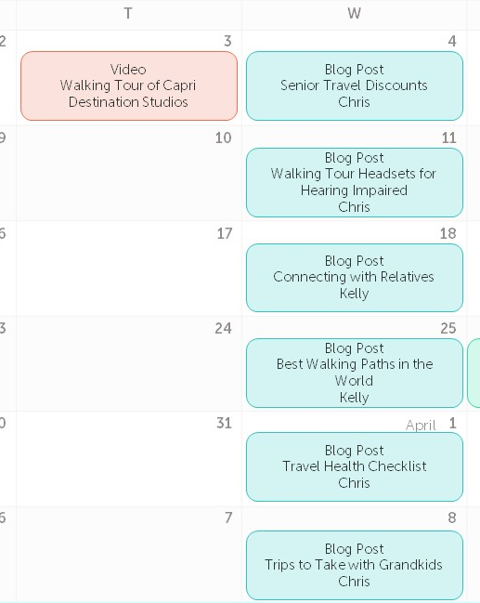
CREATE AND DELIVER THE CONTENT
The Schedule
That’s where a content calendar, or editorial calendar can come in handy. We’ve broken out our calendar into 6 week blocks or “sprints.”
Why?
Because planning a year’s worth of content at one time just isn’t effective.

Slide 41

CREATE AND DELIVER THE CONTENT
The Schedule
For example, if you’re a travel agency, a lift on the longstanding ban on travel to Cuba might alter your content strategy quite a bit.

Slide 42

CREATE AND DELIVER THE CONTENT
As a small business, you have an advantage in that you can be agile and respond quickly to market demand.
With a short term strategy, you can take advantage of shifts in the marketplace and change content direction to provide the most relevant content to your audience.

Slide 43
March
2
3
4
5
6
Video
Walking Tour of Capri
Destination Studios
Blog Post
Senior Travel Discounts
Chris
9
10
11
12
13
Blog Post
Havana Nights – Cuba Travel is Closer than You Think
Chris
16
17
18
19
20
Blog Post
Connecting with Relatives
Kelly
23
24
25
26
27
Blog Post
Best Walking Paths
in the World
Kelly
Guide
Travel Itinerary, Step-by-Step
Matt
30
31
April
1
2
3
Blog Post
Travel Health Checklist
Chris
6
7
8
9
10
Blog Post
Trips to Take with Grandkids
Chris

Slide 44
4
Measure & Optimize
Your Strategy

Slide 45

MEASURE AND OPTIMIZE YOUR STRATEGY
You’re documenting your strategy - not setting it in stone.
Your content strategy is like another member of your team. It’s a living, breathing entity that will evolve and grow along with your business.
To get the most out of your content marketing efforts, check in on how your content impacts your business. Revisit your personas, topics and delivery method and optimize your approach.

Slide 46

MEASURE AND OPTIMIZE YOUR STRATEGY
But how do you know if your strategy is working or not?
Set measurable goals.

Slide 47



MEASURE AND OPTIMIZE YOUR STRATEGY
Connect
Measure brand awareness, including likes, followers, engagement, and mentions.
Engage
Measure volume of new leads, prospects and opportunities in your sales pipeline.
Grow
Measure increase in sales from new and existing customers.

Slide 48
Next Steps

Slide 49
NEXT STEPS
You’ve documented a kick-ass content strategy that’s going to help you connect and engage with more prospects so your business can grow. So what’s next?
You can use marketing automation to leverage your targeted content.

Slide 50
NEXT STEPS
What is Marketing Automation?
Marketing automation is technology that helps businesses connect with their customers and prospects in a more personal way, while automating repetitive tasks.
We like to think of marketing automation as a way to turn website visits into handshakes, emails into conversations, and customers into raving fans.

Slide 51

NEXT STEPS
Marketing Automation
Give a Virtual Handshake
Now that you have a rock solid content strategy and friendly, useful content to share on your website, you can use marketing automation to capture leads early in their buying journey through online forms on your website.

Slide 52
NEXT STEPS
Marketing Automation
Turn Emails into Conversations
Marketing automation helps you to send one-to-one emails that address your prospects’ unique interests. You can have better conversations with your audience by sending the right person the right content at the right time.

Slide 53

NEXT STEPS
Marketing Automation
Turn Customers into Raving Fans
Marketing automation makes sure that you’re always speaking to hot prospects who are ready to buy. Instead of wasting time on cold calls, you can be engaging with legitimate sales opportunities.
Once you’ve earned a new customer, marketing automation allows you to stay in touch. So instead of feeling like just another transaction, your customers feel the love! (and they’ll spread the love too, referring great prospects who are just like them!)

Slide 54
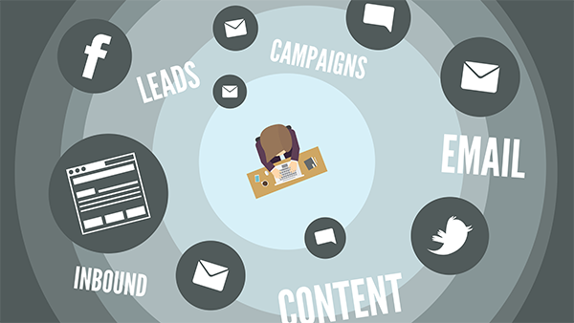
NEXT STEPS
So what gives us, Hatchbuck, the authority on content marketing?
We’re a group of marketing experts who have built an all-in one sales and marketing tool for small businesses. With over 150 years of combined marketing experience, we know a thing or two about using content to build brand awareness, drive leads, and win customers.
If you have 2 minutes, you can see how we work in our short video overview:
Watch the Video Overview

Slide 55
Your Content Strategy Playbook

Slide 56
Persona Worksheets
Build personas for the unique types of customers you’d like to target.
Copy and paste persona worksheet as needed.

Slide 58
Content Topics
Use your personas to develop engaging topics
Copy and paste topic worksheets as needed.

Slide 61
Content Medium
Decide How You’ll Deliver Your Content
Copy and paste topic worksheets as needed.

Slide 62
Medium | Tools Needed | In-House | Out-Source | Frequency

Slide 63
Content Calendar
Schedule Your Content
Copy and paste topic worksheets as needed.

Slide 64
CONTENT CALENDAR
Copy the Elements You Need & Paste To Your Content Calendar
Blog Post
Topic
Author
White Paper
Topic
Author
SlideShare
Topic
Designer
Article
Topic
Author
LinkedIn Post
Topic
Author
Webinar
Topic
Presenter
Guide
Topic
Author
Infographic
Topic
Designer
Video
Topic
Producer
Other
Topic
Author

Slide 66
About Hatchbuck
As a self-made business owner, you go to depths that others won’t to capitalize on opportunity. We get it. Hatchbuck makes small business sales and marketing software for the adventurous, the risk takers. When it comes to your business, it’s sink or swim. You can’t be anchored to bulky software. So we promise that no solution is as easy to use or as effective at engaging prospects and customers as Hatchbuck.
Hatchbuck. Seize the Opportunity.
HATCHBUCK.COM

