Slide 1
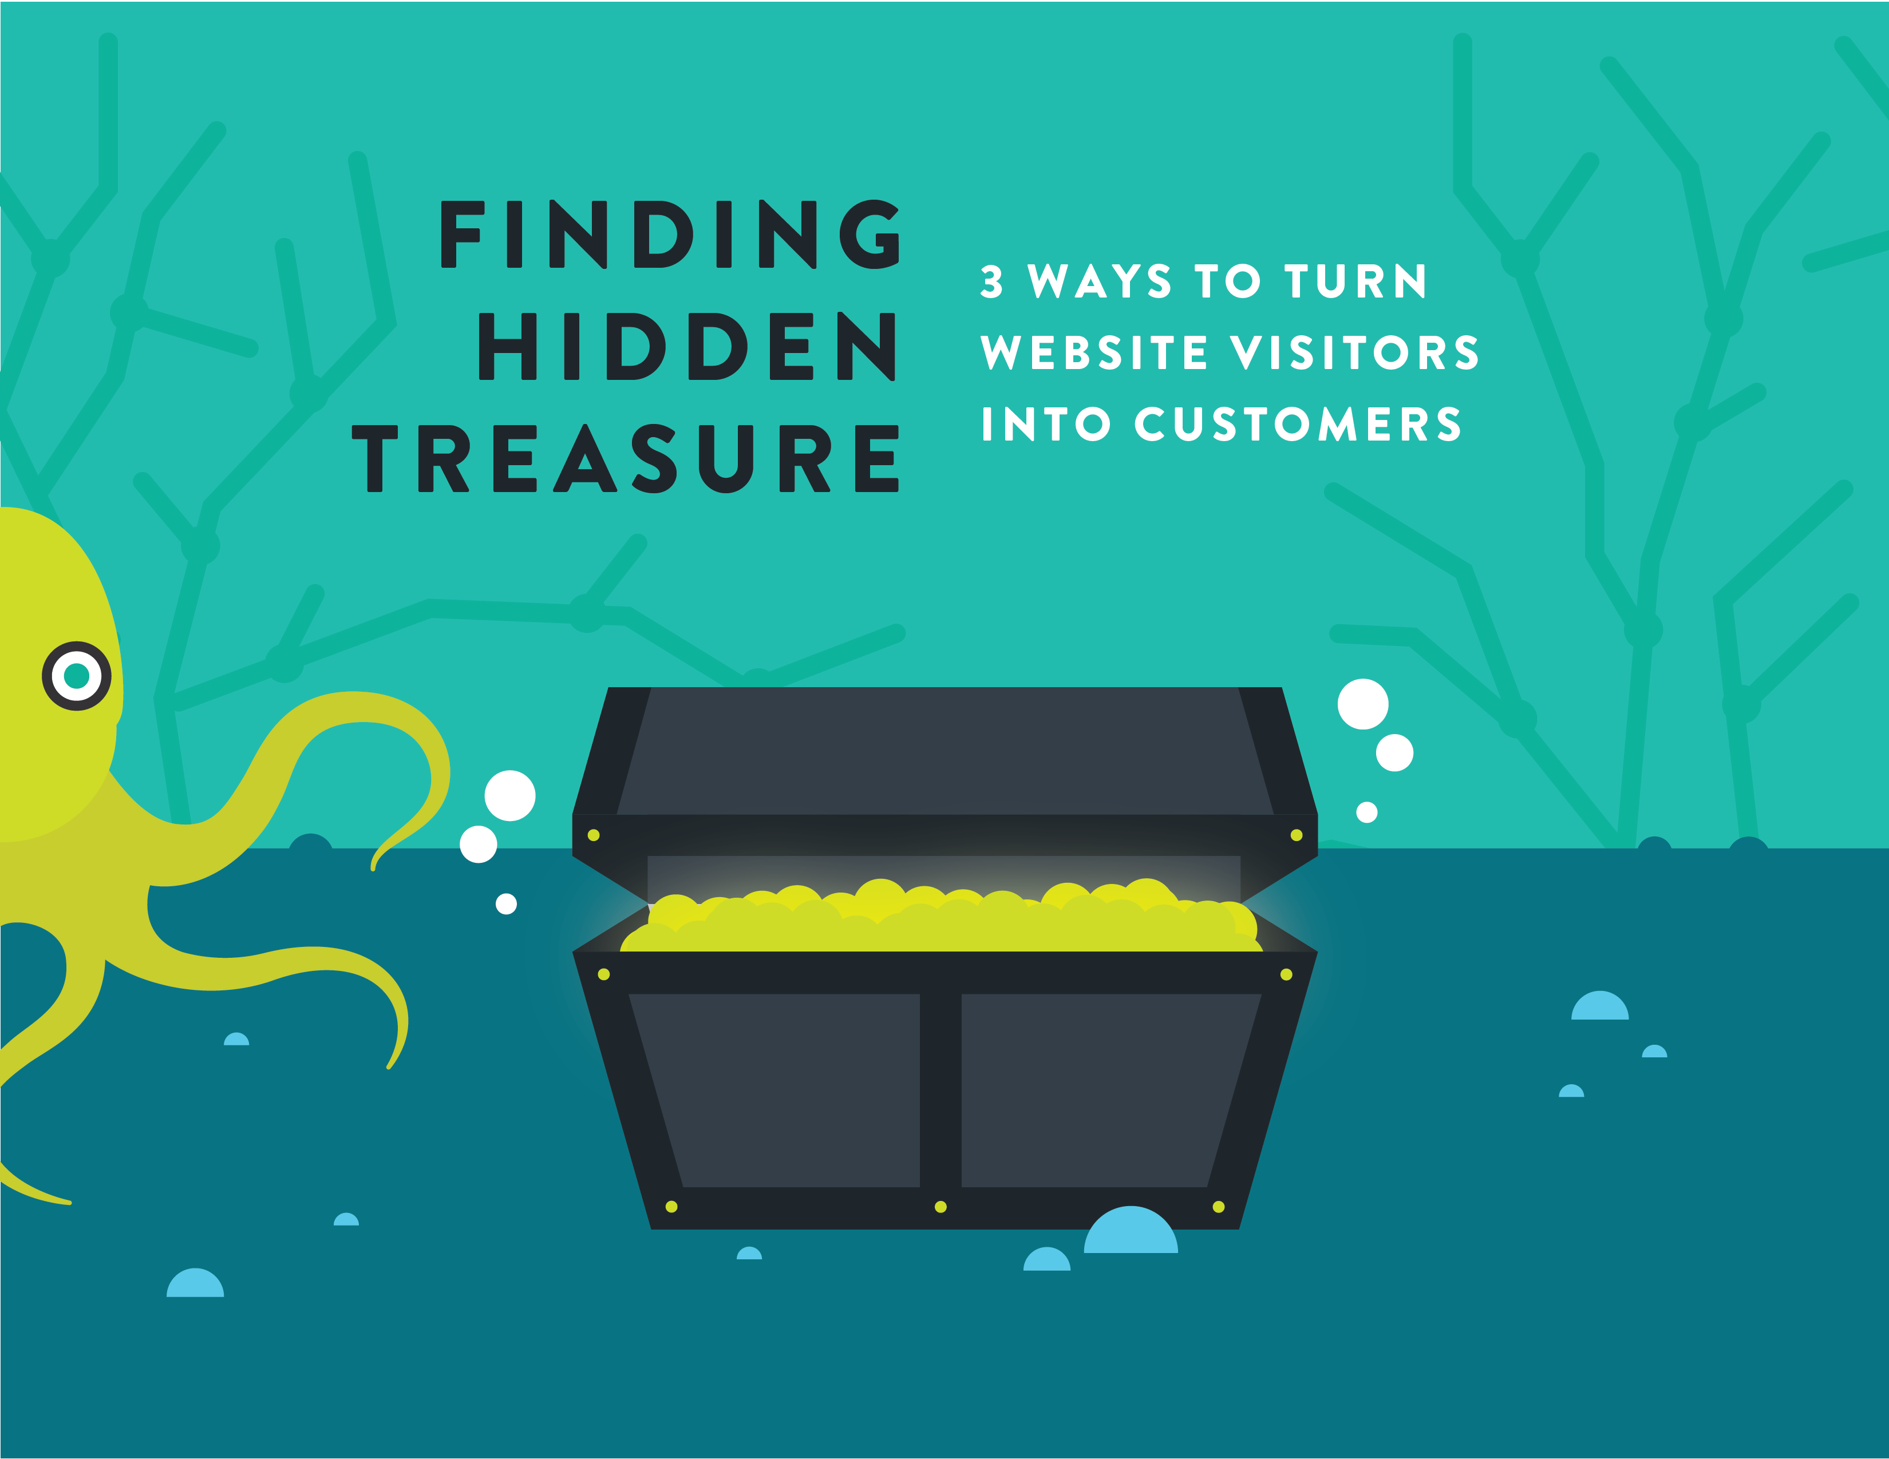

Slide 2
Hey there.
96% of people are not ready to buy from you the first time they visit your website.
(Source: Kissmetrics)
Most businesses are always looking for the “silver bullet” to drive new and repeat sales. If you’ve already invested in SEO, PPC and social media, then congrats! You’ve made it past a big hurdle that small businesses face; getting found online.
But did you know....
Today’s prospect will visit your website, your competitor’s website, industry publications, online review sites and social media.
Why? To whittle down their list of potential vendors long before ever contacting your business or any sales representative.

Slide 3
Below is a typical process that many of your prospects go through before making a buying decision:
AWARENESS
(just looking)
What is my need or problem?
CONSIDERATION
(shopping)
Does your product or service solve my problem or need?
DECISION
(buying)
Why should I buy from you?
Most prospects only want to engage with a sales rep in the last third of their buying process; the decision or buying phase. So, for two-thirds of their shopping and research process, they want to remain anonymous while they research and gather information. Think about it, don’t you do the same?
The last time a sales associate asked “May I help you?,” did you say “No thank you, I am just looking?” Chances are you did. Chances are also good that the sales associate didn’t catch your name, your info or what you were looking for in the first place. You were in the research phase of a buying decision and likely made a purchase from someone other than the nice sales associate who asked “May I help you?”

Slide 4
Your challenge is to capture and engage with prospects as early in the buying process as possible. Why?
First, by engaging with the prospect early, you’re more likely to not get cut during the selection process. Whew, that was close.
Second, early engagement provides you the opportunity to provide the prospect with the valuable information they need to make an informed buying decision… hopefully to buy from you. Now we’re talking!
By starting a relationship early in the buying process you are able to educate the prospect on their problem or challenge, the industry solutions available to them and why your particular product or service rocks and is the best solution for their specific needs.
Early engagement gives you the opportunity to provide the prospect with valuable information
needed to make an informed buying decision.

Slide 5
So how can you capture prospects early in the buying process? Simple. Use these 3 keys to wrangle in more sales leads:
Use Lead Forms
Give Value
Don’t Sell...Nurture
USE LEAD FORMS
Make sure your website isn’t just a pretty brochure. Sure, you need to cover the basics like info about your product or service, why you’re different, how to contact you etc… but you also need to make it easy for a web visitor to give you something. Capturing contact information doesn’t have to be a chore for you or your prospect.

Slide 6
Here is a great example of a site using multiple offers, including a newsletter sign-up on their home page. After all who doesn’t love a free grilling guide?
The best way to increase lead conversions is to make sure you have a clear call to action & multiple offers for your visitors’ different needs
Main website with multiple lead forms
Resource page with downloads
As a best practice include at least one lead form on your website. However, the best way to increase lead conversions is to make sure you have multiple offers throughout your site, remember you never know which pages your visitors will enter your site from or what stage of the buying process they are in.
For any lead form, only include the minimum number of fields you need to fit your sales process.

Slide 7
For example, a newsletter should require only an email address. For offers targeted further down the buying process, like product demonstrations, you may request more required info such as: first name, last name, title, phone, and email address.
Always remember to test, test, & test some more. You may find that more required fields may decrease form submissions but may yield a more qualified lead.
GIVE VALUE
Everybody loves a gift (except for Aunt Mildred’s fruit cake).
So offer something of value in exchange for their info. When a prospect visits your website, think about what challenge they might be facing. What information could help them? What would they find valuable? It’s not about you and your products and services, it’s about your prospect and what they need.
Consider offering an educational guide (like this one), video or free webinar. People don’t mind giving up their name and email address for something valuable.
Confused on how come up with offers?
It’s not about you and your products and services, it’s about your prospect and what they need.

Slide 8
Here is a handy little chart to help you with your content:
Your Prospect Is... | Looking | Shopping | Buying
Questioning | What problem do I have? | Does your solution solve my problem? | Why should I choose you?
Looking For | Thought Leadership | A Solution Fit | Credibility / Decision Validation
Needing | Infographic | Product Webinars | Product Demonstration
 | Blog / Helpful Articles | Vendor Guides | Proposal / Pricing
 | Workshops / Lunch & Learns | Competitor Matrix | Case Studies
 | How-to Guides | Product / Industry Videos | ROI Calculators
 | Influencer Interviews | Product / Industry Webinar | Testimonial / Reference List
 | Social Media | Whitepapers | Trials
 | Educational Videos |  | Offers
 | Newsletters

Slide 9
DON’T SELL... NURTURE
Once you capture a lead, help and don’t sell. People don’t want to engage with a large number of sales people early in the process for good reason. They don’t want to be hounded or “sold.” So don’t do it. Instead, nurture them.
Lead nurturing is the process of communicating with your prospects in a consistent and relevant way by providing them with information that helps their selection process. This will help position your company as the “go-to” once they are ready to buy.
While newsletters have their place, don’t just treat every prospect like an email address or number. Remember, each prospect is a potential customer and has unique needs, desires and interests.
Stats show that relevant, personal emails drive BIG results over typical, monthly newsletters.
Keep in mind there is a big difference between email marketing and lead nurturing. Think of email marketing as “one to many
communication” (ie: monthly newsletters, e-blasts to your database) and lead nurturing as “one to one communication,” (ie: personalized emails) based on past engagement with you or your online content.
“Relevant emails drive 18x more revenue than broadcast emails.”
(Source: Jupiter Research)

Slide 10
LET’S SEE THIS SIMPLE 3 STEP PROCESS IN ACTION:
Susan is browsing online and visits the “Mosquito Squad” website. Although she may not have an issue with mosquitoes at her business or residence today, she is queen of the coals and fills out the website form for the “Free Grilling Cookbook.” Her information is instantly captured and segmented in your CRM.
Don’t pick up the phone and call her! She is just doing research and downloaded a grilling guide in the process. Your time is better spent with prospects in the “Decision or Buying” phase.
Next, to help her move along the buying process, continue to nurture her with information she is genuinely interested in. pssst she likes grilling!
Marketing campaigns that nurture prospects over time are perfect for this. An automated series of personal and relevant emails that help educate the prospect and reinforce your own value proposition really can work.
“Companies that excel at lead nurturing generate 50% more sales ready leads.”
(Source: Forrester Research)

Slide 11
Integrated sales & marketing software systems are vital
in helping to deliver the right message to the right person at the right time.
The key to moving Susan closer to the hallowed “Customer” status, is tot rigger emails or communication that is based on her interaction or behavior with your content. Integrated sales & marketing software systems are vital in helping to deliver the right message to the right person at the right time. By utilizing a system that tags or segments prospects, you’re able to automatically deliver content they care about.
Susan, for example, is an avid griller but may need to have her backyard sprayed for those nasty critters in the future.
Understanding the unique needs of your prospects and engaging with them in a relevant way will pay off BIG time.
By implementing these 3 simple keys to generating more sales leads from your website, you will drive new business and educate your prospects by providing them the information THEY need to make a well-informed buying decision…
Which is to buy from you!

