Slide 1
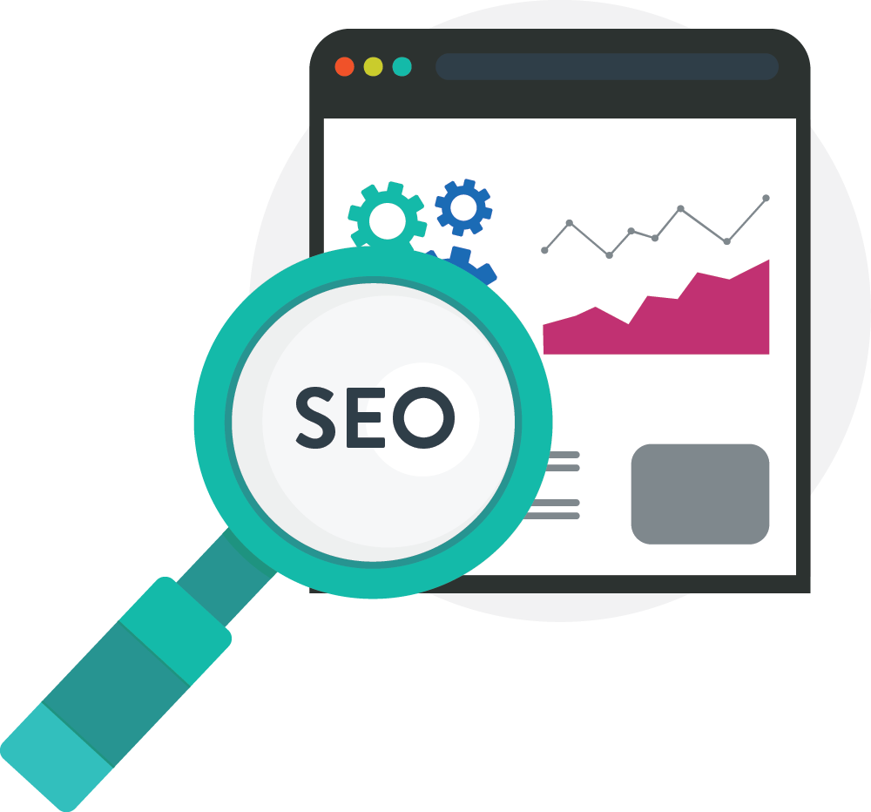
The DIY Guide to SEO
Search Engine Optimization Basics for Small Business

Slide 2
16 DIY SEO Tips to Try
Start With Personas
Plan Your Keyword Research
Find Gold in the Long Tail
Study the Competition
Blog Consistently
Eliminate Duplicate Content
Distribute and Share
Use Internal Links
Grow Your Inbound Links
Use SEO Friendly URLs
Feed the Need for Speed
Optimize for Mobile
Use Landing Pages
Don’t Forget the User
Keep up with SEO Trends
Use Analytics
Bonus: Reach Out to an SEO Agency
Cover image designed by Freepik

Slide 3
So you want to drive more online visitors to your website or increase your rankings in Google’s search engine, but don’t know where to start.
Should you hire an SEO agency, or go at it yourself? When it come to search engine optimization it can be an overwhelming process, but it doesn’t have to be.
An SEO expert or agency can help ensure that when consumers do a web search, your website is one of the first resources to appear in the search results, however…

Slide 4
Prior to paying someone else to help facilitate improved web results, you may want to try a few DIY tips yourself to give your SEO a boost.
Here are 16 do-it-yourself SEO tips that small business owners should try before hiring an SEO firm:

Slide 5
1. Start with Personas
Driving more visitors to your site starts with knowing the persona of your ideal buyer and understanding what makes them tick.
Why?
Because websites are ultimately built for humans and not robots.
So dig into their challenges, understand why they buy, and create a customer persona.
With your customer persona as a guide, you can best align SEO to your content and website strategy, helping you get found online by your ideal customer.

Slide 6
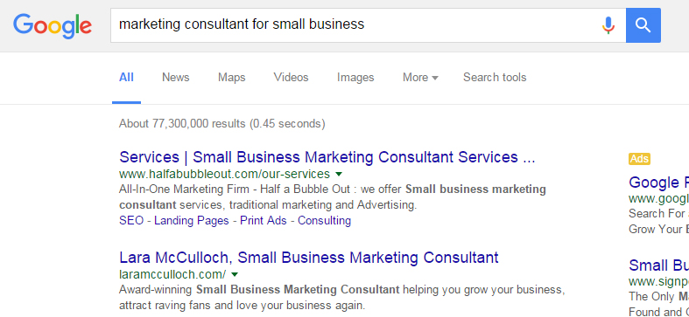
2. Plan Your Keyword Research
Before you push out a lot of content and copy on your website, make sure you plan out your keyword strategy.
Keywords are the words or phrases that your target audience searches for when looking for products and services or when trying to solve a problem in search engines like Google and Bing.
Search engines, like Google, will match up the most relevant content to the search of their user and provide the most accurate results from websites, blogs and images.

Slide 7
2. Plan Your Keyword Research (cont.)
There are a number of tools that give you valuable insights into which keywords you should focus on. Check out:
Wordstream
Ubersuggest
Google’s Keyword Planner
If you need a little assistance with your keyword research, here is a great article from Jason Demers at AudienceBloom that breaks it down step by step.

Slide 8
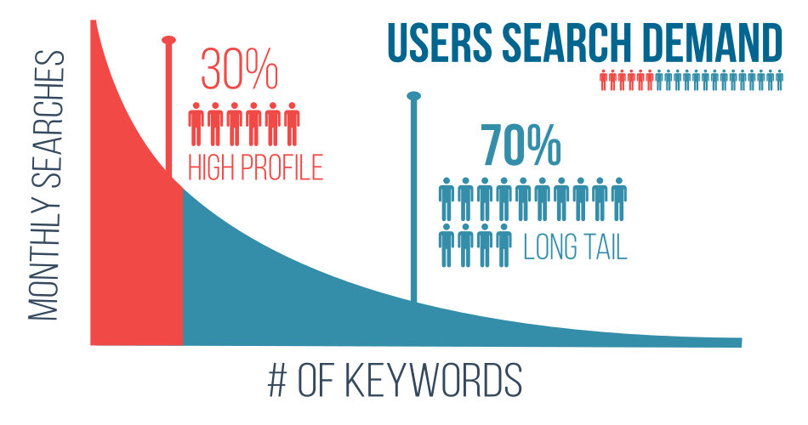
3. Find Gold in the Long Tail
For a lot of industries, ranking for the most trafficked keywords is highly effective. At the same time, trying to rank for those highly competitive terms can be a long and costly endeavor.
Long tail keywords are longer and more specific phrases that search engine users search on when they are closer to making a purchase or finding what they are looking for.
Image source: http://www.ohow.co/

Slide 9
3. Find Gold in the Long Tail (cont.)
Adding long tail keywords to your SEO strategy is key to healthy online growth.
In fact, long tail keywords make up the majority of all search engine traffic, and people come to your website from these long tail searches are highly relevant and ready to buy.
So, if you own an accounting software company, you could try to rank for an uber-competitive keyword such as “accounting software.”
However, with about 52 million searches a month and national brands vying for the top spot, you’d have to spend a ton of time and resources to get results.

Slide 10
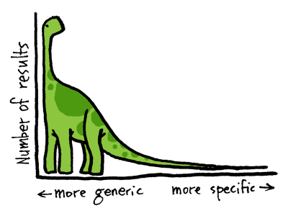
3. Find Gold in the Long Tail (cont.)
Instead, you could take a targeted and more relevant approach and try ranking for a term such as “accounting software for real estate agents.”
Not only would you spend less to rank for this long tail phrase, but people coming to your site from this keyword would be more relevant buyers.

Slide 11
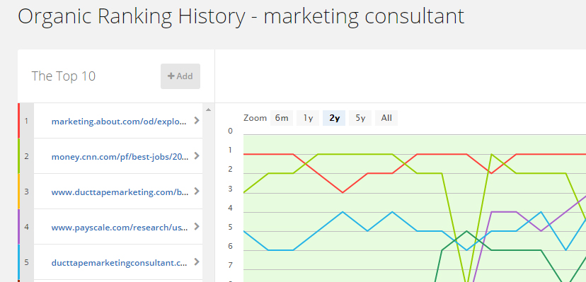
4. Study the Competition
Once you have your keyword strategy in place, identify the top competitors for each keyword and what they are doing right to get ranked in the good graces of the search engine gods.
SpyFu is a simple, cost effective tool you can use to gain better insights into your competitors paid and organic search initiatives.

Slide 12
4. Study the Competition (cont.)
Keep in mind that while competitive info can help shape your SEO initiatives, be careful not to rely solely on your competitors.
After all, your best website conversions will come from those visitors that are best aligned to YOUR ideal buyer – not theirs.

Slide 13
5. Become a Consistent Blogger
Google is always looking for new content. So while the main pages of your site don’t change every day, blogging is a great way to push up fresh, relevant content for the search engines to index.
As you blog, write your content for your ideal buyer and the challenges they face everyday. Don’t just load your blog posts with keywords.
Again, you’re ultimately trying to connect with people – not search engine robots.
Avoid keyword stuffing, but do select a primary keyword for your blog post that fits in with your keyword strategy and the terms your ideal buyer is searching for.

Slide 14
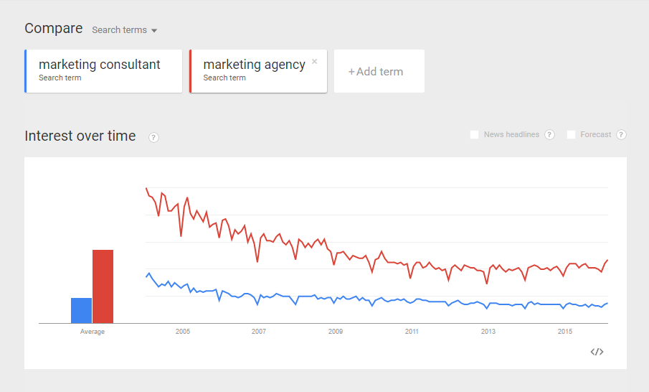
5. Become a Consistent Blogger (cont.)
Google Trends can show you which keywords and phrases are currently on the rise.
Use this tool to see if you should tweak your keyword at all to give your content the best chance at being discovered.
Google Trends Keyword Tool

Slide 15
5. Become a Consistent Blogger (cont.)
Make sure to optimize your post by making sure the keyword appears in:
The title
Body copy
Url
Meta description
Finally, you can use guest blogging as another strategy to get found online.
Identify influencers and leaders in your space who write quality content. Partner with these influencers to create content that links back to your site.
Guest blogging is a great way to boost traffic, pump up social media shares, and increase your brand equity online.

Slide 16
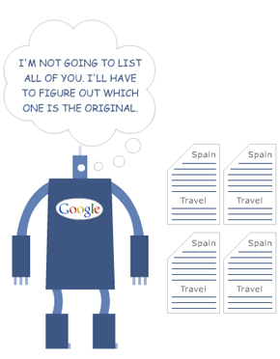
6. Eliminate Duplicate Content
The goal of Google and other search engines is to push original, relevant content to the top of search results.
To meet this goal, Google suppresses duplicate content and non valuable pages. When Google is presented with same piece of content in multiple places, it will show only one page and crowd the others out of the search rankings.
image credit

Slide 17
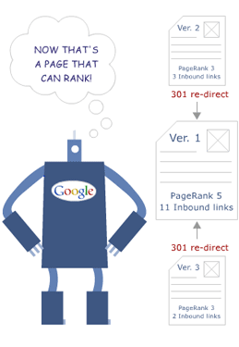
6. Eliminate Duplicate Content (cont.)
So, if you’re copying content from other places online and publishing it on your website, you could be missing out on relevant web traffic to those pages.
If you want to add content from another site, a simple best practice is to link to it and reference the original source or utilize 301 redirects from any duplicate pages to the original pages.
image credit

Slide 18
7. Distribute and Share
As your content engine is humming, look for ways to push out your white papers, guides, blog posts and resources out through multiple distribution channels.
Content distribution platform Outbrain breaks content distribution down in the following ways:

Slide 19
7. Distribute and Share (cont.)
Earned: Third-parties share or publish your content through social media, guest posts, media coverage or product reviews.
Owned: Publishing content to web properties that belong to you, like your blog, email newsletter, or social media profiles.
Paid: As the name implies, this is through paid channels, often using a pay-per-click advertising model.

Slide 20
8. Use Internal Links
With today’s heightened focus on content, internal linking is a great strategy to boost SEO.
An internal link connects one page of a website to a different page on the same website.
Internal links on webpages and in blog posts improves readability, boosts rankings for keywords, and helps to Google to crawl your site.
When you link internally try to go deep. In other words don’t just link back to your home page but to pages that are rich in content and relevant to the topic at hand.

Slide 21
9. Grow Your Inbound Links
In addition to your internal linking strategy, external link building remains one of the cornerstones of SEO and best ways to improve your ranking in search land.
The goal of inbound linking is to get outside links from sites, directories and forums that have a solid domain authority and link them back to your site.
For example, if your business gets mentioned in Huffington post, which has a higher PageRank than your website, it will boost your PageRank and Google and other search engines will reward you by increasing your position in search results.

Slide 22
10. Use SEO Friendly URLs
URLs are simply the address of a unique page on your website.
While it’s easy to set-it and forget-it when it comes to your URLs, making sure your URLs are clean and optimized essential to ranking highly in SERPs (search engine results pages).
When building URLs for your website, it’s important to make sure they are friendly, easy to read for online visitors and includes relevant words (keywords) that correlate to the copy on the page of the website.

Slide 23
10. Use SEO Friendly URLs (cont.)
Let’s say someone is looking for red men’s socks so they search Google.
By creating a descriptive, friendly URL you can increase the chances you will show up in the top search results in Google.
You’ll also improve the chances that people will click on your link because the URL is relevant and easy to digest.

Slide 24
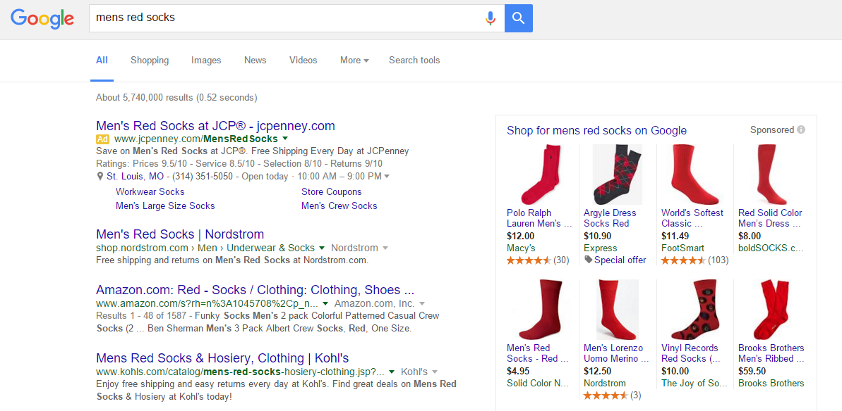
10. Use SEO Friendly URLs (cont.)

Slide 25
10. Use SEO Friendly URLs (cont.)
Notice that Nordstrom is in the #1 spot.
Their URL is:
shop.nordstrom.com/c/mem-socks/red
And…
Here is the URL for Saks Fifth Avenue’s page, found on page 10 of the search results:
http://www.saksfifthavenue.com/Men/Apparel/Underwear-and-Socks/Socks/shop/_/N-52k84v/Ne-6lvnb5

Slide 26
10. Use SEO Friendly URLs (cont.)
The descriptive and concise URL structure that Nordstrom created has helped it to outrank the Saks Fifth Avenue ad.
As a user, when I click through to the two pages from the search term “men’s red socks,” the Nordstrom page shows me red socks while the Saks Fifth Avenue page just gives me men’s socks.
Remember, Google is rewarding relevancy more and more. So, matching URLs and content together both improves your SEO and gives your conversion rates a boost.

Slide 27
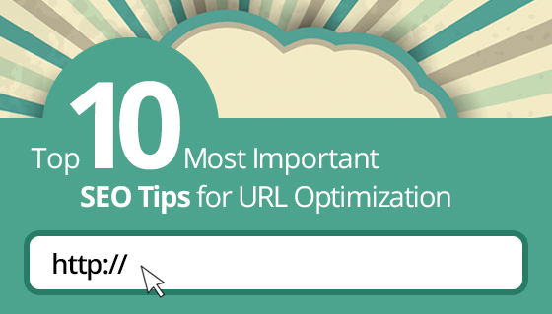
10. Use SEO Friendly URLs (cont.)
Bonus Tips:
Try to keep URLs short making them easy to type and read.
Eliminate unnecessary words such as and, the, and symbols such as @.
Use hyphens instead of underscores as Google has a hard time recognizing them and won’t index your page.
MySiteAuditor has 10 Helpful Tips to make sure you keep your URLs tidy and friendly.

Slide 28
11. Feed the Need for Speed
Believe it or not, how fast your site and your pages load are critical to how Google ranks your site for SEO.
Not only does page load speed impact your search rankings, but it affects the experience your users have when they engage with your website.
In a world of online options, visitors won’t stick around for pages, images and videos to load.
In fact, pages with longer load times tend to have higher bounce rates and lower conversion rates. Here is a great post from Moz to help you optimize your page speed.

Slide 29
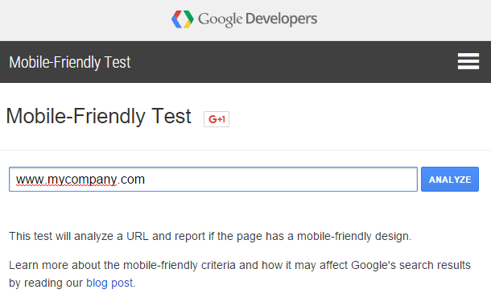
12. Optimize for Mobile
More and more people are using their mobile device to search online which means it can be a major source of traffic and conversions for your business.
Studies show 70% of mobile searches lead to an online action within just one hour. Recently Google launched a mobile-friendly update designed to give a nod to pages that are mobile optimized.

Slide 30
12. Optimize for Mobile (cont.)
This is a quest by the mother of all search engines to provide the best possible experience for its users when looking for products and services.
If you want to find out if your pages are mobile-friendly you can simply utilize Google’s tool that checks your URL for mobile-friendliness.

Slide 31
13. Use Landing Pages
A landing page is a stand-alone page on your website where visitors land from sources such as search engines, PPC, social and email marketing.
Landing pages are a great tool to drive focused traffic to your site and get more visitors to convert into leads for your business from search.

Slide 32
13. Use Landing Pages (cont.)
Most landing pages typically use a form to capture and convert visitors.
When creating landing pages in WordPress or one of the landing page tools such as Instapage, don’t forget to optimize for SEO with your keywords and use relevant content with a specific call to action (CTA).

Slide 33
14. Don’t Forget the User
Most websites are still built for the way Google used to rank. They’re often overloaded with keyword jargon and not optimized for humans.
But current day search engines have put algorithms in place to measure a website’s user experience and reward sites that put UX (User Experience) into practice.
Elements like clean site navigation and sitemaps help users to discover content more easily and help your website to be indexed effectively, making sure search engine bots can more easily crawl your site.

Slide 34
14. Don’t Forget the User (cont.)
It’s the quality of traffic and not always the quantity of traffic that is going to grow your customer base.
When you build your website around the user and focus on adding value for the user, visitors will stay on your site longer, digest more content, subscribe to your lists and connect with you to learn more. Bounce rates will decline and conversions will climb.

Slide 35
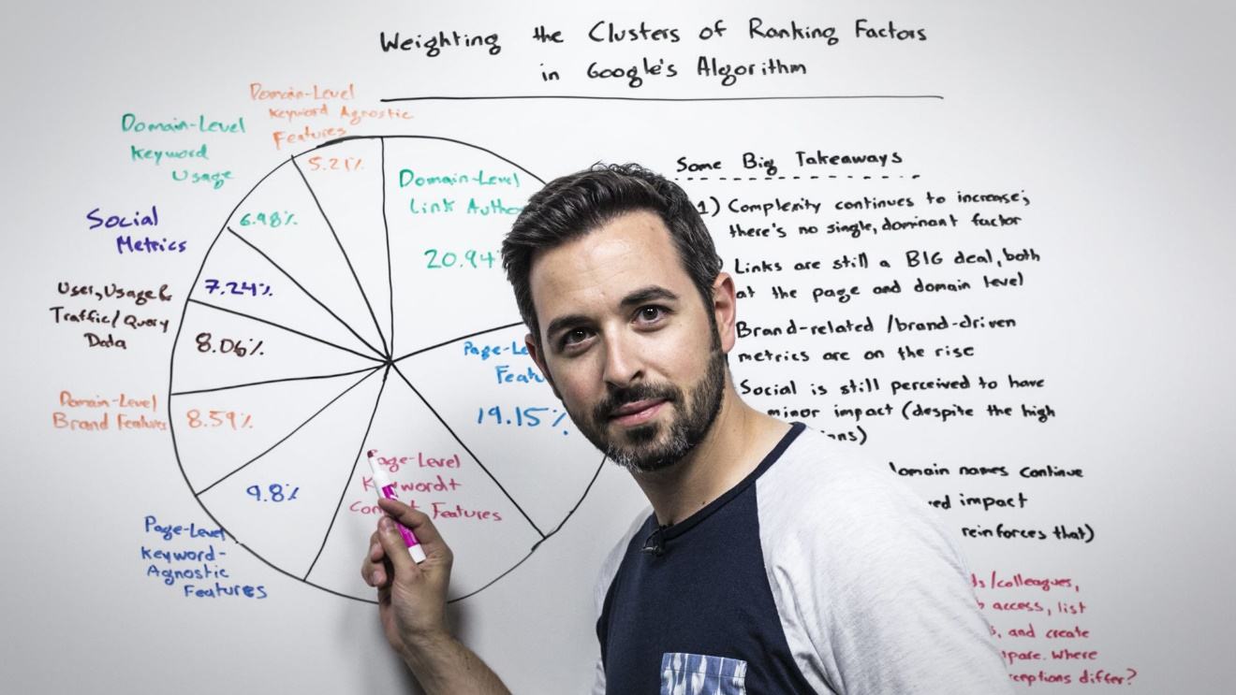
15. Keep Up with SEO Trends
Search engine optimization is an ever changing landscape. Staying at the top of search rankings consistently takes keeping up to date with trends, news, and new concepts.
Sign up for SEO blog newsletters and check out these sites:
Search Engine Watch
Search Engine Land
Industry leading SEO Sites
Moz’s Whiteboard Friday
Google Webmasters

Slide 36
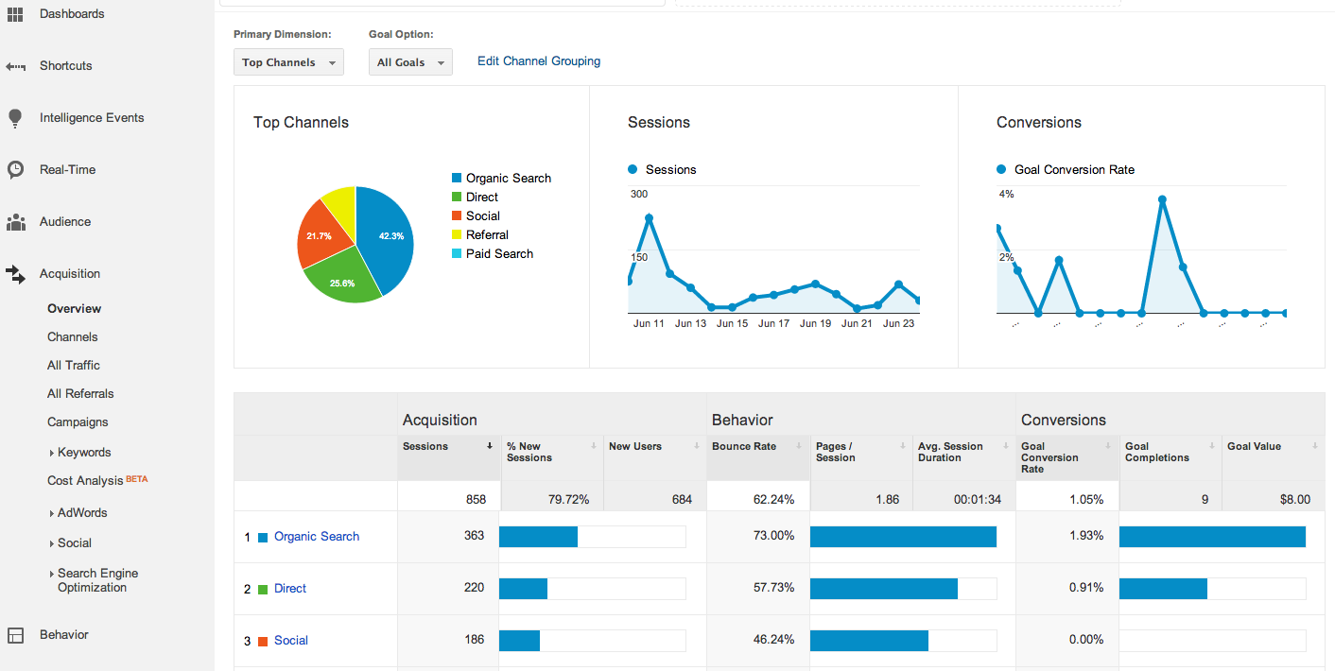
16. Use Analytics
As you make changes to improve SEO, you need insight into what’s working and what isn’t.
Google Analytics is a free tool to help you to monitor your traffic, see which sources most of your traffic is coming from, learn which landing pages are converting the most traffic into prospects for your business, and measure the overall conversion rate of your website.

Slide 37
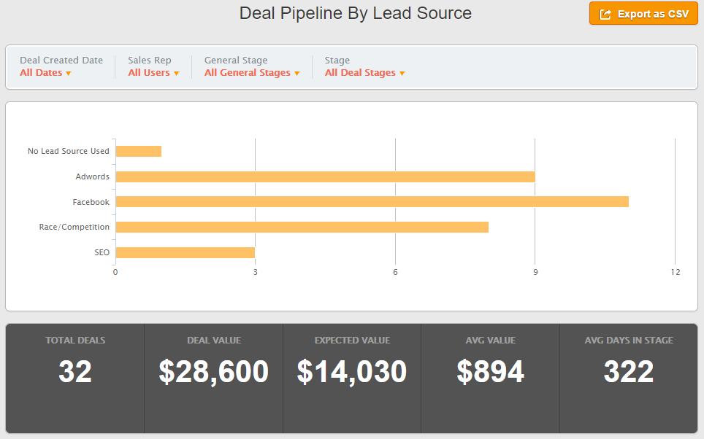
16. Use Analytics (cont.)
In addition to website analytics, you want to make sure that the traffic your driving eventually converts into new customers for your business.
Tracking the lead source of each prospect in your CRM can tell you which sources your customers are coming from, and measure how many folks become customers by finding your website online.

Slide 38
Bonus: Reach Out to an SEO Agency
The DIY tips provided here are designed to give you a solid foundation to help you build an effective SEO strategy and get found online.
However, depending on the competitiveness of your industry and the resources of your business you may want to reach out to an SEO firm or consultant to help you along the path.
When looking for the right SEO firm ask lots of questions, understanding their linking strategy, what analytics they will provide you with, and don’t forget speak in depth to relevant references.

Slide 39
About Hatchbuck
Self-made business owners go to depths that others won’t to capitalize on opportunity. We get it.
Hatchbuck makes small business sales and marketing software for you - the adventurer, the risk taker. When it comes to your business, it’s sink or swim. You can’t be anchored down by bulky software. So we promise that no solution is as easy to use or as effective at propelling relationships into sales as Hatchbuck.
Hatchbuck. Seize the Opportunity.

