Slide 1
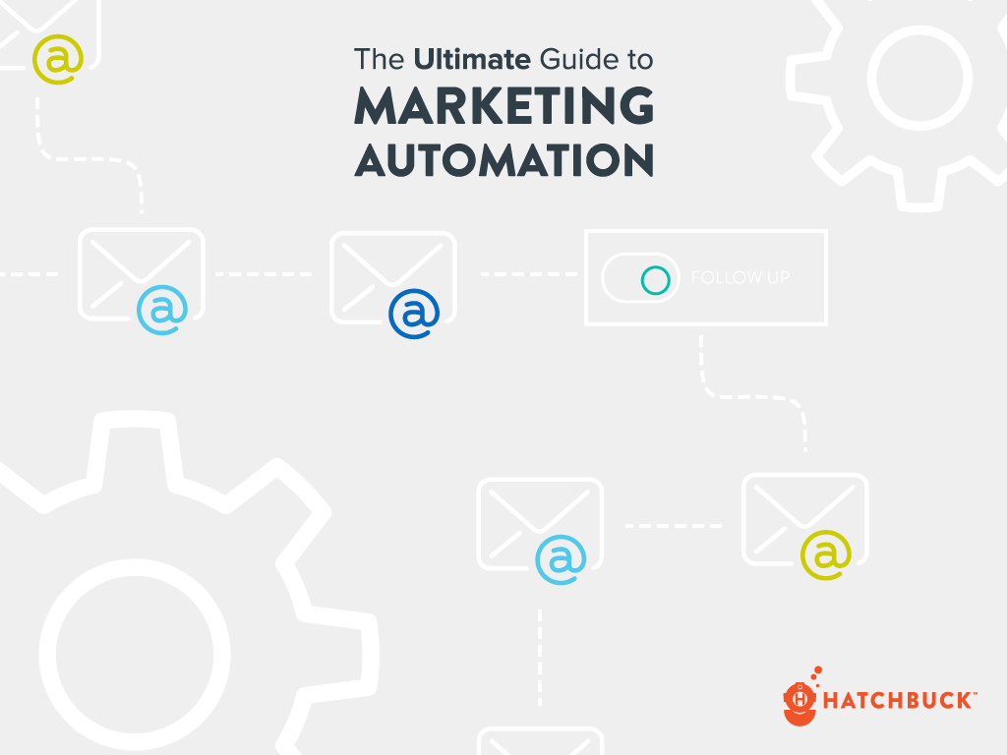

Slide 2
As a small business owner, the center of your business operations and information revolves around you.
But what happens if you can’t be reached?
What happens if you want to take some time to work on big picture projects for your business? And, we know it’s a long shot, but what happens if you want to take a vacation?

Slide 3
The fact is, you’re never too small to put a process in place.
Yet, for small businesses, creating a sales and marketing process is one of the biggest hurdles faced.

Slide 4
If you know you can leave the office and your business will hum along to a happy tune, congratulations. You probably have a great sales and marketing process.
But, if you spend all day putting out fires and feel like your business would burn to the ground without you, this is your guide.

Slide 5
We’re going to do a deep dive into how to put a sales and marketing process into place with the help of sales and marketing automation.

Slide 6
This guide isn’t short, but it’s complete - and completely worth it if you want to create a sales and marketing process that generates leads and customers. A process you can step away from, giving you free range to work on your businesses instead of in it. A process you can easily scale to accelerate revenue by investing in the right channels to grow.

Slide 7
We’re going to give you all of the tools you need to re-examine sales and marketing and find ways to automate your process. And, while this guide is intensive, the steps to creating a sales and marketing process using automation are actually pretty simple…

Slide 8
Identify your ideal buyer
Attract them to your website
Capture their contact information
Have a friendly conversation
Convert them into a customer
Make sure they dig your company
Attract more customers just like them

Slide 9
It’s a repeatable process that’s fueled by content and powered by sales and marketing automation.
It all starts with getting personal with your best customers.

Slide 10
GETTING PERSONAL
If your process is automated, does it depersonalize the customer experience?
While “sales and marketing automation” sounds impersonal, it can actually deliver a much more personalized experience. Christine Brett, Director of Digital Strategy at GPrX Data, said it best:
When I talk to other businesses about marketing automation it typically scares them off because they have this preconceived notion that it’s some robotic form of marketing or communication with their contacts. What I have found using Hatchbuck is it is just the opposite effect. There are a number of features that we love and that have allowed us to be much more personal and responsive to our leads and customers…

Slide 11
GETTING PERSONAL
I was recently at a trade show and was able to look up someone in Hatchbuck that I hadn’t met prior to the event. I noticed he had visited our website and clicked on a number of the emails I had sent him. By having insights into Bill’s activity, my conversation with him was more informed and personal than I could have ever had before. It turned the discussion from what I wanted to sell him to what was most important to him.
-Christine Brett | Director of Digital Strategy
@ GPrX Data

Slide 12
GETTING PERSONAL
We love that marketing automation did exactly what it was supposed to do for Christine - help her have a meaningful conversation with a potential buyer.
However, marketing automation is the last piece of the puzzle when it comes to personalizing your sales and marketing process.
The first step is to understanding your ideal buyer so you can go above and beyond to deliver a sales and marketing experience that wows and attracts the right type of customer to your business.

Slide 13
GET TO KNOW
YOUR IDEAL
BUYER

Slide 14
GET TO KNOW YOUR IDEAL BUYER
Whether it’s a Buzzfeed Tasty video in your Facebook feed, or yet another cold sales email in your inbox, everyone is vying for a moment of your time.
“Hey, look this way!”
Your potential customers feel it, too. So how do you get their valuable attention?
You can’t be generic. You’ve got to get to the heart of the matter - for something that matters to your audience.

Slide 15
GET TO KNOW YOUR IDEAL BUYER
Forget about what you want (another sale). Instead, create a personalized experience based on what your potential customer wants.
Everyone has a unique agenda, interests and obstacles.
So what’s on the mind of your potential buyer? To find out, you have to commit.
Your target market may be hundreds, thousands, or millions of people. You could try to please them all - but with watered-down, generic marketing tactics, you’ll never get personal enough to win over anyone.
To become the champion of your customers you have to champion them. This means going all in to attract one specific type of buyer.

Slide 16
GET TO KNOW YOUR IDEAL BUYER
BUYER PERSONAS
If you want to provide a personal sales and marketing experience, you have to do it with a person in mind.
That’s where buyer personas come in. A buyer persona is an archetype of the type of customer you want to attract. It helps you uncover why and how your customers make a purchasing decision.
For instance, say you’re in the wellness industry and own a CrossFit gym.
You have several types of customers to start with:
Pro athletes, weekend warriors and people in the midst of their weight loss transformation.

Slide 17
GET TO KNOW YOUR IDEAL BUYER
They all have different agendas and different goals. At the same time, another CrossFit gym has popped up on the other side of town.
How do you attract more new clients to keep your classes full? How do you keep your loyal customers coming back when competition is at your heels?
You do it by going all-in on one buyer persona.
After doing a bit of customer analysis and seeing where your business’s strengths really shine, you decide to put your stake in the ground.
You decide to attract more customers like Charlie.

Slide 18
GET TO KNOW YOUR IDEAL BUYER
Charlie is a great customer because customers like Charlie tend to stay with your gym longer, boosting their customer lifetime value.
Unlike your pro athlete clients, Charlie doesn’t push for equipment and specialized training that’s outside of your scope.
And unlike your weight loss focused clients, Charlie doesn’t need health and nutrition services that are outside of your expertise.
Charlie is an awesome, steady client that brings in lots of revenue for your business. You’d love more customers just like Charlie.

Slide 19
GET TO KNOW YOUR IDEAL BUYER
Charlie
Age
Description
62
Charlie is a Baby Boomer who’s never going to be satisfied with retiring to the couch.
Goals
Obstacles
Travel and stay active. Charlie takes a trip to go climbing with his buddies every year. He and his wife are avid bikers. Now that the kids are gone, they look forward to big excursions. This year, they plan to travel to South America’s tropical rain forest.
He doesn’t like to admit it, but he isn’t as young as he used to be. Being active all his life has been great for his health, but has been hard on his body at times. His knees are a trouble spot. A hip or knee replacement isn’t far off in the future.

Slide 20
GET TO KNOW YOUR IDEAL BUYER
With your buyer persona, you have some awesome insights about your ideal customer.
Now you can get to work creating an awesome customer experience for Charlie:
You provide a modified WOD (workout of the day) to accommodate Charlie’s bad knees.
You team up with the physical therapist next door to offer help with new and recurring injuries.
You plan a yearly trip for gym members, merging Crossfit with Charlie’s desire to travel and explore.

Slide 21
GET TO KNOW YOUR IDEAL BUYER
And now that you know exactly who you’re going to attract, you know how to help Charlie find you in the sales and marketing process:
You update your website to show CrossFitters who look like Charlie - not like pro athletes.
You partner with your local AARP chapter to offer a free intro class to members.
You create a series of online training videos specifically for Charlie & his unique obstacles.
You offer a checklist for download on your website, “Can I Really Do CrossFit? 20 Questions to Ask if You’re Over 50.”

Slide 22
GET TO KNOW YOUR IDEAL BUYER
Buyer personas keep marketing on the right track.
Buyer personas address your ideal buyer’s challenges and motivations, whether you are creating an email marketing campaign, sending out a direct mail piece, or updating your website content.
With buyer personas, you can champion your ideal buyer, and in return, they’ll champion your brand.

Slide 23
ATTRACT
YOUR IDEAL BUYER
TO YOUR WEBSITE

Slide 24
ATTRACT YOUR IDEAL BUYER
Now that you’ve identified your ideal buyer and created your buyer persona (Charlie), you can start attracting more Charlies to your website.
That means being where Charlie is. And, in today’s fragmented digital marketing landscape, Charlie is in a lot of places.
To be successful, you have to uncover which channels do the best job of bringing your ideal buyer to your website and convert him into a customer, channels like:
Social Media
Your Blog
SEO
PPC
Events

Slide 25
ATTRACT YOUR IDEAL BUYER
Social Media
Social media is a powerful tool for small business. It’s a terrific way to build a following, foster a two-way conversation with prospects and customers and build trust with your audience.
The facts back it up:
Unless your ideal buyer is a technophobe, they’re probably on social media. There are 1.55 billion monthly active users on Facebook. That’s about 1 in 5 people. LinkedIn has more than 400 million users, and Twitter boasts 320 million active users each month. (Outbound Engine).

Slide 26
ATTRACT YOUR IDEAL BUYER
The average American is on Facebook for 40 minutes each day. And Facebook users are sharing roughly 1.3 million pieces of content every minute. Quality content that resonates with your ideal buyer on Facebook gets eyes on your brand. (SproutSocial)
Twitter reports that 74 percent of customers follow a small business in order to receive updates on future products and services, and 70 percent will retweet content they enjoy from a brand. (Twitter)
TWEET THIS
TWEET THIS

Slide 27
ATTRACT YOUR IDEAL BUYER
Twitter also found that 47 percent of customers who follow a brand are more inclined to actually visit the company’s website as well, and 72 percent of a business’s followers are likely to make a purchase. (Twitter)
Before using a business, 90 percent of consumers research it online, and 88 percent find online reviews just as trustworthy as personal recommendations. (B2C). Your social media profiles often show up in the top search results for your brand, so what your customers say has major influence on prospects.
TWEET THIS
TWEET THIS

Slide 28
ATTRACT YOUR IDEAL BUYER
To get the most out of your social media presence, share great content that resonates with your ideal buyer. Encourage reviews and participate in conversations with your prospects and customers.
And, don’t forget to make it easy for interested prospects to get to your website when they are ready to buy.
Your Blog
You don’t have to have a blog. But if you want potential customers to find your business online, you should probably have a blog.
Interesting content is one of the top three reasons why people follow brands on social media.

Slide 29
ATTRACT YOUR IDEAL BUYER
And since we’ve already covered why social media is so important, creating original, relevant content to share there dovetails nicely with your sales and marketing strategy.
With solid blog content, you have fuel to stoke the fire on social media. Blog content also drives inbound links to your site when brands related to your audience pick up and share your articles.
It’s also no secret that search engines like Google and Bing love good blogs. The more quality content you produce, the more likely it is that your company will be found in search results.

Slide 30
ATTRACT YOUR IDEAL BUYER
If you’re skeptical, consider these blogging stats from Business2Community:
Small businesses that blog get 126% more lead growth that those who don’t.
79% of companies with a blog reported a positive ROI for inbound marketing.
B2B marketers who blog generate 67% more leads than those who don’t.
Blogs are 63% more likely to influence purchase decisions than magazines.
70% of customers say blogs influence what they buy.
78% of consumers believe businesses that provide custom content are interested in building good relationships.
TWEET THIS
TWEET THIS
TWEET THIS
TWEET THIS
TWEET THIS
TWEET THIS

Slide 31
ATTRACT YOUR IDEAL BUYER
Keep your business blog up to date with content that resonates with your ideal buyer if you want to extend your reach, get found online, and generate sales leads.
SEO
If you made a purchase recently - whether it was to buy a new pair of shoes or invest in software for your business - you probably didn’t spend a dime without typing a phrase into Google, first.
SEO is all about getting your business’s website to appear in the search results.
So, if Charlie goes to Google and types in:
Crossfit near me
Crossfit for bad knees
Crossfit training videos
Crossfit over 50…

Slide 32
ATTRACT YOUR IDEAL BUYER
…you want to be at the top of the search results.
Here’s why:
81% of B2B purchase cycles start with web search. 90% of buyers say when they are ready to buy, “they’ll find you.” (Earnest Agency, 2014)
57% of B2B marketers say SEO has the biggest impact on lead generation. (NewsCred, 2014)
On average, organic search leads have a 14.6% close rate, versus 1.7% for outbound marketing leads. (NewsCred, 2014)
The highest spenders are more likely to turn to organic search for information. (Marketing Pilgrim, 2014)
TWEET THIS
TWEET THIS
TWEET THIS
TWEET THIS

Slide 33
ATTRACT YOUR IDEAL BUYER
On average, conversion rates are 10 times higher from search than from social on desktops. (Perform Insider, 2015)
Every month there are more than 10.3 billion Google searches, with 78% of U.S. internet users researching products and services online. (B2B Marketing, 2014)
Fresh, quality content - like we touched on when we talked blogging - is essential to SEO. It helps you tell search engines what topics are relevant to your business.
Plus, publishing new content frequently encourages search engines to crawl your site more often, getting your content in the search results faster.
TWEET THIS
TWEET THIS

Slide 34
ATTRACT YOUR IDEAL BUYER
In addition to good content, social media may influence your search engine ranking. (Digital Marketing, 2014).
Although we don’t know the exact algorithm Google uses, brands do see a correlation between social media engagement and search rankings.
So if you’re already working on your blog and social media, you have a leg up on SEO. However there’s still a lot to learn. If you want to dig deeper into SEO, our DIY Guide to SEO is a resource you need to check out.

Slide 35
ATTRACT YOUR IDEAL BUYER
PPC
Social media, blogging, and SEO drive quality, organic traffic to your website. However, a lot of that traffic may not be ready to buy just yet.
If you’re looking for the instant sale, invest in PPC (Pay Per Click) advertising to bring hot prospects to your website.
With PPC, you bid on search terms that are highly relevant to your business, or use data-driven targeting to serve up your ad to extremely relevant audiences.
Most digital marketers consider Google Adwords as table stakes for PPC. Google Adwords shows the text ads that appear at the top of organic Google search results.

Slide 36
ATTRACT YOUR IDEAL BUYER
So, when Charlie types into his Google search bar: CrossFit Gyms
Your ad shows up on the top of the page, above even the organic search results.
To make sure you get all of the Charlie’s in the door (and to avoid attracting those pro-athletes that are a bit of a drain on your gym) use ad copy strategically:
CrossFit for Boomers
For guys who aren’t ready to retire
to the couch. Beginners welcome.
Try a free class.

Slide 37
ATTRACT YOUR IDEAL BUYER
In addition to text ads, Google Adwords serves display ads on websites that are part of the Google Ad Display Network (that’s over 1 million websites).
Say Charlie visits your website, but doesn’t sign-up for a class.
Google follows him to other sites he visits around the web, and show your display ads there. That way, your business stays top-of-mind for Charlie.
Oh, yeah, I wanted to sign-up for CrossFit. Let’s do it!

Slide 38
ATTRACT YOUR IDEAL BUYER
While Adwords is most popular, the search engine, Bing, is rising as an affordable alternative. In fact, in Wordstream’s article, What’s in Store for PPC in 2016?, search engine analyst David Szetela predicts that Bing Ads will be viewed as must-have by a growing number of advertisers in 2016. “This will be driven by the fact that the increasing click inventory will continue to be priced below Google CPCs,” Szetela says.
In addition to Google Adwords and Bing Ads, Facebook and Twitter pay-per-click ads are getting a lot of attention. With the vast amount of user data on these platforms, businesses can reach super targeted audiences at a lower cost-per-click.
If you still aren’t persuaded to try PPC, here are a few stats that might sway you:

Slide 39
ATTRACT YOUR IDEAL BUYER
Businesses make an average of $2 in revenue for every $1 they spend on AdWords. (Google Economic Impact Report).
The top 3 paid advertising spots on the search results page get 46% of the total clicks on the page. (PowerTraffick).
YouTube (part of the Google Ad Display Network) has a monthly viewership equivalent to roughly 10 Super Bowl audiences. (Wishpond).
45% of people can’t tell the difference between organic and paid search results. (Wishpond).
TWEET THIS
TWEET THIS
TWEET THIS
TWEET THIS

Slide 40
ATTRACT YOUR IDEAL BUYER
Pay-per-click, like SEO, is another meaty subject. But like other marketing channels, the goal is the same: drive your ideal buyer to your website where you can convert them into a customer.
Events
While your ideal buyer is going to be online at some point during the sales and marketing process, that doesn’t mean he or she won’t pop up at an event, like a trade show, conference or happy hour.
Networking face-to-face at events can be valuable to your business, as Center for Exhibition Industry Research (CEIR) and BizActions have found:

Slide 41
ATTRACT YOUR IDEAL BUYER
99% of exhibitors find unique value delivered by B2B tradeshows which are not provided by other marketing channels.
77% of executive decision makers found at least one new supplier at the last show they attended.
51% of tradeshow attendees requested that a sales representative visit their company after the show.
46% of executive decision makers made purchase decisions while attending a show.
The cost of a face-to-face meeting with a prospect at a tradeshow is $142. The cost of a face-to-face meeting at a prospect’s office is $259.
76% of executive decision makers asked for a price quotation at the last show they attended.

Slide 42
ATTRACT YOUR IDEAL BUYER
88% participate in trade shows to raise awareness of the company and its brand.
72% participate to get leads from new buyers and prospects.
70% to strengthen relationships or partnerships.
65% attend to see current clients – it is harder to get face to face time with clients.
Your business can get the most out of live events by making sure you can get in touch with attendees before, during and after the event.
A good communication strategy drives attendees to your business during the event and continues the conversation long after the event has ended, directing your ideal buyer back to your website where they can convert into a customer.

Slide 43
ATTRACT YOUR IDEAL BUYER
A healthy sales and marketing strategy drives your ideal buyer - you know, more Charlies - to your website. And, ideally, your business should test a few, if not all of these channels to increase relevant traffic to your website.
But, what happens when your ideal buyer lands on your website?
Does Charlie have a clear path to becoming your newest CrossFit client when he hits your landing page?
Or does he bounce immediately, leaving you with no way to get in touch with him, the perfect potential client?

Slide 44
CONNECT WITH
YOUR IDEAL BUYER
ON YOUR WEBSITE

Slide 45
CONNECT WITH YOUR IDEAL BUYER
When it comes to small business websites, they tend to be more like a digital brochure, showing off products or services.
Small businesses don’t always think about opening their virtual door to greet the good leads that visit their site.
In fact the majority – 70% of small business B2B websites – lack a call to action, according to Anita Campbell of Small Business Trends.
A Call to Action (CTA) is a text hyperlink, button, or image on your website designed to encourage potential visitors to take an action.

Slide 46
CONNECT WITH YOUR IDEAL BUYER
Placing clear CTAs throughout your site in exchange for valuable resources – like webinars, how to guides, checklists, and product offers – transforms your website from a digital brochure to a lead generation engine.
CTAs also help your visitors to better understand what you expect them to do (learn more!) and what actions to take next (schedule a call!).
Without these call-to-action prompts on your website, your visitors will bounce without learning anything more about your business, and without leaving any follow-up information behind.
“Download Our Resource,” “Check Out Our Product,” and “Buy Our Product are CTAs to consider adding to your website to keep the conversation going with your ideal buyer.

Slide 47
CONNECT WITH YOUR IDEAL BUYER
Download Our Resource
According to Kissmetrics, 96% of people are not ready to buy from you the first time they visit your website, but that doesn’t mean you aren’t able to capture your ideal buyer early in the buying process.
Don’t let good prospects bounce. Offering a lead magnet on your website grows your sales pipeline.
A good lead magnet attracts your ideal customer early in the sales process by addressing a specific problem they might be struggling with.
If you’re trying to connect with Charlie, for instance, you could offer a free download of “10 WODs to Try for Crossfitters over 50.”

Slide 48
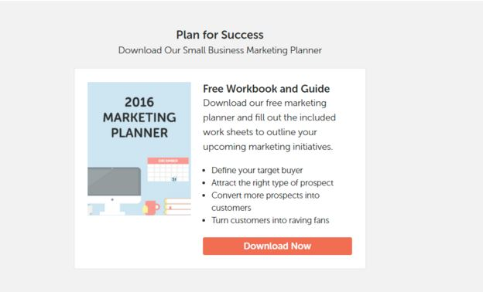
CONNECT WITH YOUR IDEAL BUYER
Offering a resource in exchange for your ideal buyer’s contact information gives your visitors tools they can use to be successful - and grows your lead pipeline at the same time.
Here is another great example of a lead magnet from the Hatchbuck homepage:

Slide 49
CONNECT WITH YOUR IDEAL BUYER
The marketing planner lead magnet on our home page was crazy successful at growing our pipeline. In fact, we drove over 1200 new leads into our sales funnel in just 2 weeks.
If you aren’t sure what type of lead magnet to build for your website and need a little inspiration, here are 6 simple lead magnets to test on your site.
Bonus tip:
Keep your lead magnet form short a sweet. A name and email address might be all you need to start a conversation with a lead.
Asking for too much information can actually deter leads from filling out your form.

Slide 50
CONNECT WITH YOUR IDEAL BUYER
Instead, use your content as a way to segment your leads and their interests.
For instance, we know that anyone who requests our marketing planner is looking at revamping their marketing strategy – but isn’t necessarily ready to look at marketing automation.
At the same time, someone who requests our marketing automation guide is further in their buyer journey. They are probably ready to look at software and may be interested in bottom-of-the-funnel content like a case study or customer testimonial.

Slide 51
CONNECT WITH YOUR IDEAL BUYER
Check Out Our Product
Once you have a visitor on your site, don’t forget the obvious – make it easy for them take the next step to engage with your product(s).
A prominent product CTA button on your homepage and throughout your site gives potential customers a clear way to find out how your product meets their specific needs.
There are a number of ways to showcase your product depending on your industry and sales process.
For some businesses a “Live Demo” leading to a consultative meeting with a sales rep may be the best fit. For others, a “Self Guided Tour” can give prospects all the information they need before they sign.

Slide 52
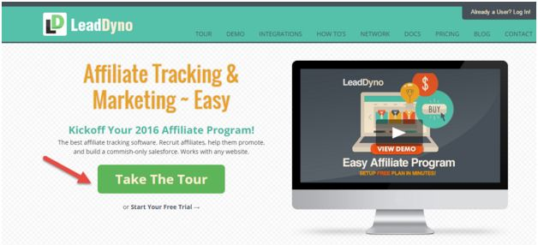
CONNECT WITH YOUR IDEAL BUYER
For example, you could have a CTA on your website to sign up for a free CrossFit class for beginners to get more Charlies into the sales pipeline.
Here’s another example. LeadDyno has a “Take a Tour” button on their site that sends visitors to a quick overview video of their software.

Slide 53
CONNECT WITH YOUR IDEAL BUYER
As a best practice, highlight your product CTA by differentiating it from any other CTA buttons you use on your site.
Keep the button color and button text consistent throughout your site, so when a visitor is ready to dive into your product, they instantly know where to click.
Bonus Tips:
Keep this call to action above the fold.
Think about common traffic areas, like the top navigation, pages that describe your products and even relevant blog articles.
Keep button text simple and aligned with the offer on the page the user clicks through to.

Slide 54
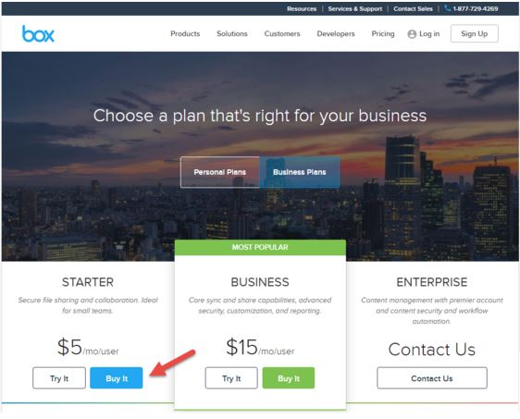
CONNECT WITH YOUR IDEAL BUYER
Buy Our Product
Once your prospects have engaged with your online resources and know more about your product, don’t miss the opportunity to ask for the sale.
This means using specific call to action buttons that make it easy for your new customers to sign up for your products or services, like it this example from Box.

Slide 55
CONNECT WITH YOUR IDEAL BUYER
Box uses simple CTA buttons to get visitors in the buying process. Bold “Buy It” buttons capture those who are ready to do business now. A less highlighted “Try It” button for a 14 day trial captures those not quite ready to take the plunge. Lastly, for users with more complex needs, a “Contact Us” CTA creates a better experience for enterprise visitors.
When your ideal buyer engages with your call to action and fills out a form to download a resource, check out your product, or make a purchase, you open the door to better leads early in the sales cycle, giving you the opportunity to close business sooner and more often.

Slide 56
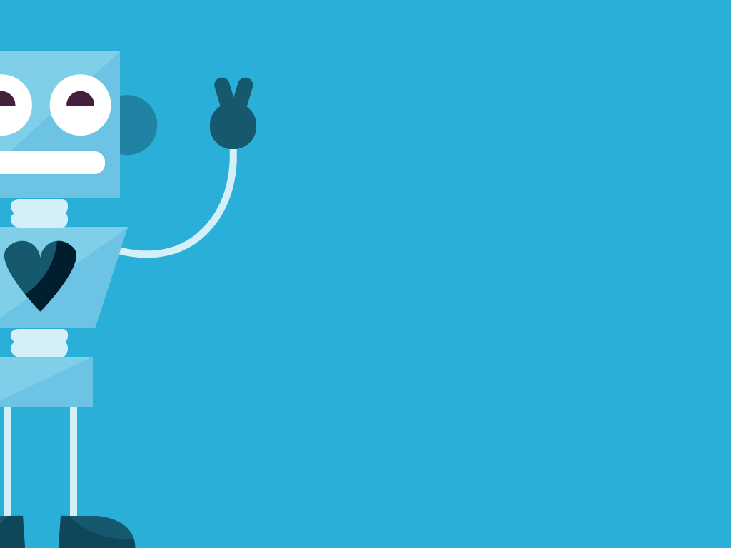
INTRODUCE
AUTOMATION
TO YOUR PROCESS

Slide 57
INTRODUCE AUTOMATION
So far, you’ve done a lot of work to get the right people to your website:
You identified your ideal buyer.
You attracted your ideal buyer to your website through channels like social media, your blog, SEO, PPC & events.
You optimized your website with clear CTAs that connect you to leads - even early on in their buying process.
At this point, you’ve set the stage to introduce marketing automation into your sales and marketing strategy.
If it’s your first encounter with marketing automation, you might be bracing yourself for something that’s high-tech, impersonal, robotic, and maybe a bit vague.
But that’s not the case.

Slide 58
INTRODUCE AUTOMATION
In reality, businesses leverage marketing automation to squeeze more revenue out of the sales pipeline.
It’s pretty simple, really.
Marketing automation captures leads, automates repetitive tasks, and engages with contacts in a relevant, personal way.
It starts with capturing leads on your site. Marketing automation powers the call to action forms on your website.
So, when Charlie fills out the form to download “10 WODs to Try for CrossFitters over 50” from your website, marketing automation can trigger behind-the-scenes actions, like…

Slide 59
INTRODUCE AUTOMATION
Add contact information to a database. Ideally, your marketing automation software is integrated with a CRM (customer relationships management system) so that your sales team can follow-up with your marketing leads.
Send an autoresponder. When Charlie submits the form, you can automatically send him an email that has the link to the checklist he downloaded.
Create a task. You can automatically assign a task to your sales team to give Charlie a call to see if he has any questions about CrossFit.
Add a tag. Tags segment your contacts. Add a “Checklist Download” tag to Charlie’s profile. Then, when you find a Work Out of the Day you want to share, you can easily pull a list of everyone who downloaded the WOD checklist and send them a super relevant email.

Slide 60
INTRODUCE AUTOMATION
Start an email campaign. Charlie downloaded your checklist, but he’s still just in research mode. Automatically start Charlie on an email campaign to keep him excited about staying fit and active with CrossFit, and help him convert to a client when the time is right.
Marketing automation pulls leads from everywhere into one central location, and automates the next step. So let’s talk about the next step - lead nurturing.
When a new lead engages with your call to action, but doesn’t convert into a customer, it’s time to…

Slide 61
START A FRIENDLY
CONVERSATION

Slide 62
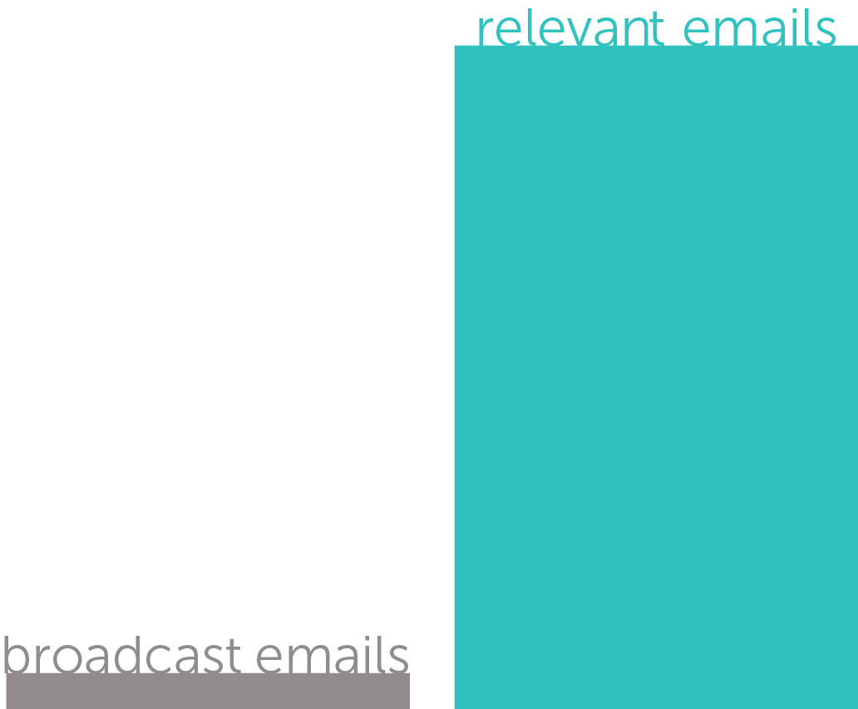
START A FRIENDLY CONVERSATION
When it comes to modern marketing, personalization is key. In fact, personalized, relevant emails drive 18 times more revenue than broadcast emails. (Jupiter Research).
When you communicate with your prospects in a relevant way, email opens and click-through rates improve, while unsubscribes and spam complaints decline.
With better email metrics, overall deliverability increases, meaning you can reach even more inboxes with your message and your brand.

Slide 63
START A FRIENDLY CONVERSATION
A Close Look at Email Marketing
Although marketing automation does the heavy lifting when it comes to getting the right content to the right person at the right time, knowing email marketing basics ensures that you’re getting the most out of every email you send.
That means improving important email metrics like deliverability, open rates and click through rates.
The more your contacts engage with your emails, the more likely your emails will reach the inbox - and stay out of the spam folder.
It all starts with a clean list of good contacts.

Slide 64
START A FRIENDLY CONVERSATION
The worst thing you can do is to blast a bulk email to an old, cold list of contacts. Here’s why:
Contacts who did not opt-in to your email list may mark you as spam.
Old opt-ins who haven’t heard from you in a while may have forgotten that they opted-in, causing them to unsubscribe or mark you as spam.
Old email addresses may no longer be active, causing your email to bounce.
Contacts on your list who never open your emails have a negative impact on your overall engagement rates.
To clean up your email list, take these steps…

Slide 65
START A FRIENDLY CONVERSATION
Send a re-engagement email to old contacts, re-opting them into your list to decrease spam complaints.
Remove people from your list who have received several emails from you, but are not opening them.
Remove any bad or faulty email addresses from your list to decrease bounce rates.
A clean email list is a giant leap toward reducing bounces, unsubscribes and spam
complaints. At the same time, because you’re sending to a list of clean, engaged prospects, your open rates and click-through rates rise.
Those high engagement rates are what email service providers love to see – getting your emails into the inbox more often.

Slide 66
START A FRIENDLY CONVERSATION
Right Person. Right Message. Right Time.
You might be used to sending one-time email blasts to everyone in your database. While the monthly email newsletter still has its place, people in your sales pipeline have been conditioned to tune-out impersonal bulk emails.
With marketing automation, you can get more personal than ever before.
Instead of reaching everyone at once with the same message, you reach out to the right person, with the right message, at the right time.
In addition to capturing leads on your website with forms, marketing automation’s web page tracking monitors which pages your leads are visiting on your website. This makes it easy to collect data for individual contacts on a mass scale.

Slide 67
START A FRIENDLY CONVERSATION
With marketing automation humming in the background of your site, you can send leads content that they’re actually interested in.
And, if you’ve been blogging to attract new visitors to your website, you’ve already got an warehouse of content you can dip into to create targeted email campaigns.
Everyone is at a different stage of the buying journey (Just Looking, Shopping, Buying), and stats show that on average, 50% of your leads are qualified, but just not ready to buy. (Gleanster)
If you just sent everyone on your list the same sales pitch, most of your qualified leads would quickly tune you out, unsubscribe, and move on.

Slide 68
START A FRIENDLY CONVERSATION
Instead, marketing automation lets you send your ideal buyer the content he really wants, nurturing him into a customer down the road.
It’s a great way to squeeze more revenue out of your pipeline. So how is it done? Lead nurturing - or email nurturing as we like to call it – is your secret weapon to turning more leads into customers over time.
Email Nurturing
An email nurturing campaign is simply a sequence of emails that are sent over time - powered by marketing automation.
To use email campaigns to get your leads closer to the sale, think about their journey as a buyer:

Slide 69
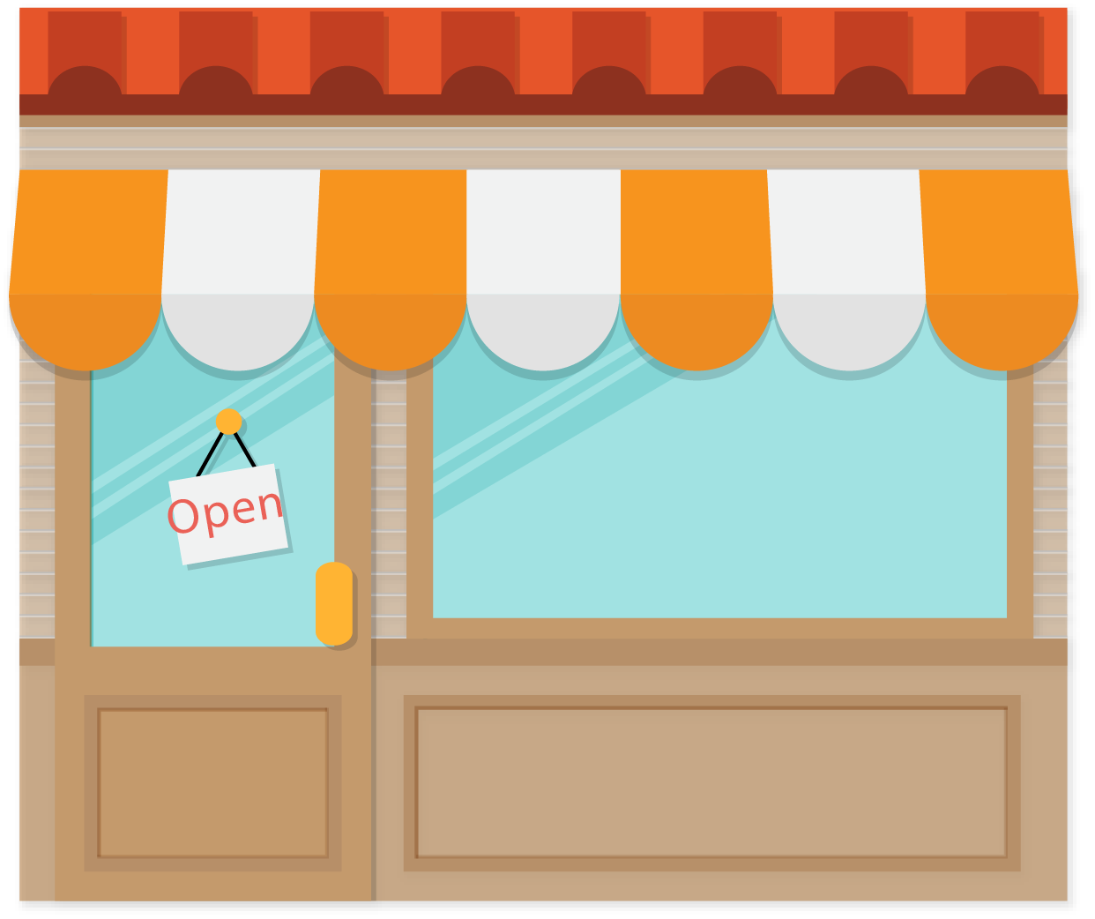
START A FRIENDLY CONVERSATION
Just Looking: At first, your leads are just window shopping. They don’t want to be in a high-pressure sales situation - they’re just browsing. Gently introduce them to your brand by sending them content on the topics they’re most interested in.
Shopping: They decided they’re ready to shop around – looking at features and pricing. Now they’re familiar with your brand, you can increase their interest by providing an in-depth look at your business and the products you have that best meet their agenda.

Slide 70
START A FRIENDLY CONVERSATION
Ready to Buy: It’s decision time for your lead, and time for you to ask for the sale. A special offer might be just what they need to get in the door.
Closed: They’ve become a customer (closed-won) or are moving on (closed-lost).
Nurturing doesn’t stop once you win or lose a customer. Don’t miss the opportunity to cross-sell and upsell, increasing customer lifetime value.

Slide 71
START A FRIENDLY CONVERSATION
Bringing it Together
So, when Charlie (your ideal buyer) visits your CrossFit website and hits your “Workouts” page, you can automatically start him on an email campaign that sends him one new workout every week for 10 weeks.
Each email Charlie gets adds value to his day. It also drives him back to your website.
There, he learns more about CrossFit and how it can change his life.
Then, when he hits your “Class Schedule” page, you know that he’s interested in actually coming to your gym - so you automatically email him an offer for a free class to get him in your door.

Slide 72
START A FRIENDLY CONVERSATION
This email nurturing strategy can all be powered by marketing automation. You build targeted email campaigns based on what your visitors are interested in, driving them down the sales funnel.
Stats show that only 20% of your leads are sales-ready when they come in.
Of the remaining marketing leads, 79% never convert into sales, often due to a lack of nurturing and follow-up. (MarketingSherpa).
Generating leads is the tough part - blogging, social media, SEO, PPC, and in person marketing take a lot of work to get people to your website and into your database.

Slide 73
START A FRIENDLY CONVERSATION
So don’t squander those hard-earned leads.
Instead of starting out your relationship with new leads with an impersonal sales pitch, have a friendly conversation. Nurture them into customers by taking them down a path unique to their preferences.

Slide 74
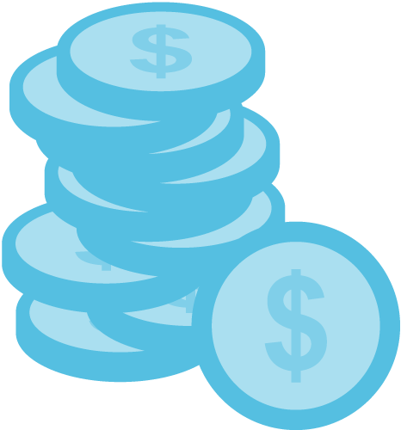
SPOT HOT SALES OPPORTUNITIES

Slide 75
SPOT HOT SALES OPPORTUNITIES
As you’re nurturing your prospects with super-targeted email nurturing campaigns, you’re probably itching to close some deals. But when is it appropriate to reach out to a lead with a sales call?
Marketing Automation Meets It’s Better Half: CRM
Your sales and marketing automation strategy isn’t complete without a Customer Relationship Management system, or CRM.
A CRM is a database that houses all of your contacts. It includes data like name, email address, contact information, notes and tasks to help you keep track of your relationship with prospects and customers.
While your marketing team works with marketing automation to capture and nurture new leads, your sales team works from the CRM.

Slide 76
SPOT HOT SALES OPPORTUNITIES
The sales team uses the CRM database to call sales leads, take notes and managing their progress through the sales pipeline.
You can integrate marketing automation with an existing CRM, or, even better, opt for an all-in-one sales and marketing platform that has marketing automation and CRM in one package.
Either way, tying these systems together is essential if you want to track your contacts through the entire customer lifecycle - from lead, to prospect, to customer.
Let’s take a step back to look at the hand-off between marketing and sales…

Slide 77
SPOT HOT SALES OPPORTUNITIES
You identified your ideal buyer.
You attracted them to your site through marketing channels like social media, your blog, SEO, PPC and events.
You optimized your website with clear CTAs .
You used your CTAs to capture leads and automatically pull them into your CRM database.
You nurtured leads that weren’t ready to buy with targeted email nurturing campaigns.
Buying Signals
As leads click on links in your emails, go back to your website, visit different pages, and submit more forms on your site, marketing automation is helping you learn a lot more about them – and helping you to pick up on buying signals you might not notice otherwise.
For example…

Slide 78
SPOT HOT SALES OPPORTUNITIES
If Charlie visits your website 10 times to check out new exercise demos, it could be a signal to call him and get him into a class already.
If Charlie signs up for a free intro class, but doesn’t convert to a customer, you definitely want to follow up with him.
If Charlie visits your class schedule page more than once, it’s probably the right time to give him a call to see if you can help him.
Where marketing automation is super powerful, is that it can alert your sales team when your hottest prospects indicate that they’re ready to buy.
You can create an action to email a sales rep, or create a task for a sales rep in the CRM anytime someone exhibits a buying signal on your website.

Slide 79
SPOT HOT SALES OPPORTUNITIES
One of our Sales Consultants, Jamie, explains how marketing
automation has made an impact on his sales strategy:
At Hatchbuck, we really eat our own cooking. Before I started using Hatchbuck, I’d spend a lot of time handing out business cards at local networking events and making outbound calls, bracing myself for a lot of “no’s” before I could generate any interest.
The beauty of marketing automation is that it takes the guesswork out of connecting with hot leads. It delivers interested prospects to my door. I literally have not made a cold call in since 2012, when I started at Hatchbuck.
Every day, I’m following up with people who are aware of our brand, have been educated on our product, and are in the decision making process. My time is spent closing new business instead of trying to generate leads.

Slide 80
SPOT HOT SALES OPPORTUNITIES
Marketing automation turns an outbound “push” strategy to an inbound “pull” strategy. Instead of interrupting your audience with cold calls and ads, your audience finds you early in the sales process when they are just starting their research. Then, they’re systematically nurtured with personalized email campaigns until they signal that they’re ready to buy.
This means that your sales team can spend more time working through their task list and closing deals, and less time hunting for prospects. That’s awesome for your sales team, who would rather be making commission than cold-calling. It’s also good for your business, because you can be more efficient and more profitable with the same size team.
That’s the power of marketing automation.

Slide 81
DELIGHT YOUR
CUSTOMERS

Slide 82
DELIGHT YOUR CUSTOMERS
Now that you’ve learned how to pin-point your ideal buyer, attract him to your website, nurture him through the marketing funnel and convert him into a customer, your work is done, right?
Well, not quite - there’s one more crucial piece of the sales and marketing puzzle that marketing automation can help with: Customer Engagement.
You’ve put a lot of work into creating customers, and losing them is like having a leaky toilet (something I know too much about): The water level stays the same, but the bill keeps climbing higher and higher.
With marketing automation, you stop costly customer leaks, and drive more customers back into your sales funnel.

Slide 83
DELIGHT YOUR CUSTOMERS
Cross-Sell & Upsell
Acquiring new customers takes time and costs money, so if you can keep your customers coming back, your business will thrive. Use marketing automation to squeeze even more revenue out of your existing customer base. Send out a birthday coupon, introduce a compatible product or service, or offer an opportunity to upgrade.
For instance, send Charlie a discount to your week long summer Crossfit Bootcamp.
With a strategy to cross-sell and upsell you can squeeze more revenue out of your existing customer base.

Slide 84
DELIGHT YOUR CUSTOMERS
Surprise & Delight
The ability to surprise and delight will turn satisfied customers into raving fans of your brand. Send swag to your most enthusiastic customers. Say thanks by inviting top customers to an exclusive event. Share a hot resource with your customers for free. Unveil a behind-the-scenes look at your latest product or service.
So invite Charlie and everyone else you have tagged in your CRM as a “VIP Customer” a special invitation to the ribbon cutting ceremony at your new crossfit gym opening.
Nurturing your customers after the sale keeps your brand top of mind, and encourages customers to refer others to your business, which brings us to...

Slide 85
DELIGHT YOUR CUSTOMERS
Generate Referrals
If you continue to nurture, surprise and delight your customers, they’ll be happy to refer their friends and colleagues to your business. While happy customers generate word of mouth sales, don’t be afraid to kick it up a notch by sending a referral campaign. Ask for referrals outright, or offer an incentive to send business your way.
As you nurture your customers with an awesome experience, you’ll be first in line when they refer a friend or make a repeat purchase.
Boosting customer sales increases the lifetime value of your customers, decreases the cost of new leads, and makes a big impact on your bottom line.

Slide 86
Marketing automation helps you create a simple, repeatable and scalable process. It’s as easy as…
Identify your ideal buyer
Attract them to your website
Capture their contact information
Have a friendly conversation
Convert them into a customer
Make sure they dig your company
Attract more customers just like them

Slide 87
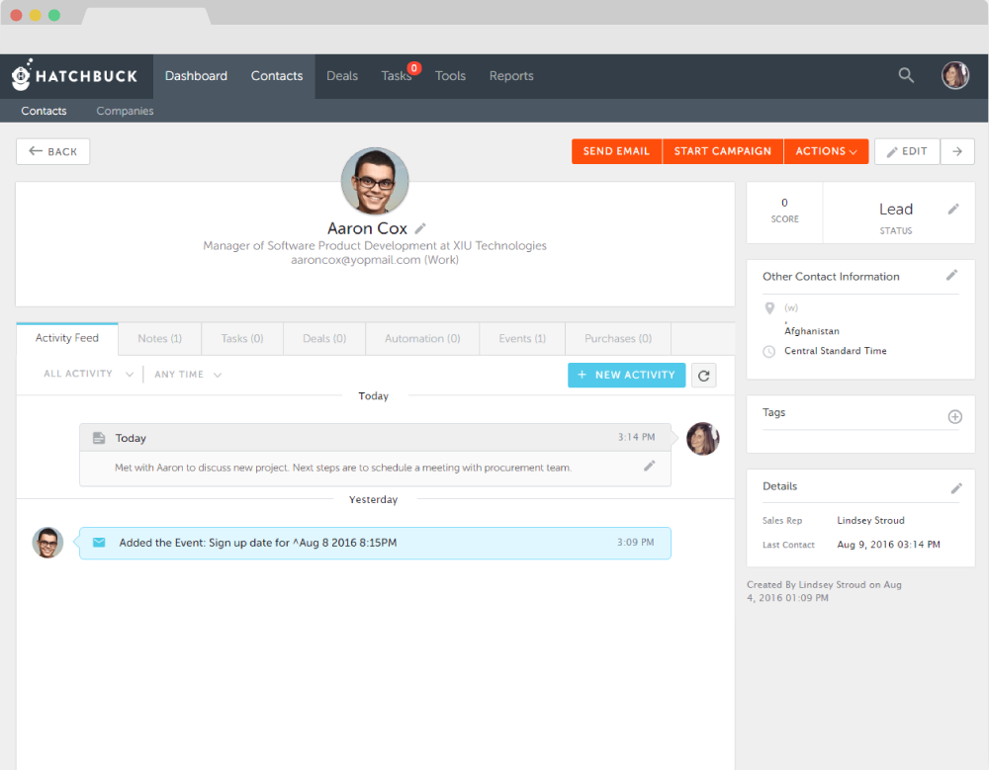
SEE MARKETING AUTOMATION IN ACTION
Now that you know how to automate your sales and marketing process with marketing automation, see how it can work for your business. Watch our quick tour.
QUICK TOUR
All-in-one sales and marketing software for you, the self-made. Get Started.

Slide 88
ABOUT HATCHBUCK
SALES & MARKETING SOFTWARE FOR THE SELF-MADE
Self-made business owners go to depths that others won’t to capitalize on opportunity. We get it. Hatchbuck makes small business sales and marketing software for you - the adventurer, the risk taker. When it comes to your business, it’s sink or swim. You can’t be anchored down by bulky software. So we promise that no solution is as easy to use or as effective at propelling relationships into customers.
Hatchbuck. Seize the Opportunity.

